Slide 1

COOPERATIVE EXTENSION
2027 OPERATING BUDGET PRESENTATION
FY27 - Budget Request
Presenter: Director, Philip Hensley
Date: August 4th, 2026

Slide 2
Vision, Mission & Values
Cooperative Extension
    VISION
  Cooperative Extension provides research-based education & programs addressing topics in agriculture and natural resources, food safety & security, family health & well-being, and 4-H youth development.
COOPERATIVE EXTENSION
    MISSION
  Cooperative Extension translates the science of everyday living for farmers, families, and communities to foster a healthy and prosperous Georgia.
    VALUES
  Cooperative Extension is an unbiased, results-driven organization utilizing a state-wide network of committed specialists, agents, and volunteers working to improve the lives of Rockdale County citizens, strengthen connections to essential services and resources, and foster economic growth and education in Rockdale County.

Slide 3
Opportunities & Challenges
SUCCESSES
OPPORTUNITIES
CHALLENGES
4-H
4th-6th youth in 4-H DPA.
  60% placed 1st, 2nd, 3rd
After-school programs covering:
  Time Management, Professionalism, Workforce Readiness, Resume Creation
Presence in 10 schools during the ‘25-’26 school year:
  Public Speaking & Science Ed (supporting Georgia Language Arts & Science standards)
FACS
Lunch ‘N Learns with County HR Team.
Senior Center cooking demos & wellness classes.
Rockdale Eats A Rainbow
  80 attendees over 6-week program
ANR
Plant-A-Row garden donations to RER.
Wellness Garden completion:
  Seed starting, Trellis garden, Pumpkin patch, Native plants, Pollinator Census
ADA accommodations & compliance.
Staff vacancies filled.
Expanded marketing & promotion of events/programs (website, blogs, new partnerships).
Broaden collaborations with organizations in & around Rockdale
  Global Growers Network
  Historic Westside Garden
  Food Well Alliance
  Center for Urban Agriculture
  Rockdale SWCD
Creation of Program Development Team for needs assessment.
Expanding ADA accessibility to outdoor spaces (Trellis Horticultural Therapy Garden).
Wellness Garden programming & features (Tai Chi, Aquaponics, WaterSmart, Container gardens, Invasive species ID, Master Composter, Raised beds, etc.)
Creation of 4-H Garden Club.
Price increases (travel, supplies, equipment).
Struggle for Federal & State grant opportunities and affiliated programs (SNAP-Ed, USDA, UGA).
Increased need for donations & fundraising efforts.
Youth transportation to statewide events.
New staff, New responsibilities, Adapting to an AI-driven world.

Slide 4
FY27 Goals & Initiatives
Department’s Reimagine Rockdale Strategic Plan
Access
Cooperative Extension Services
- Soil, water, and forage quality testing, plant disease & insect diagnostics, consultations with homeowners, growers, and businesses, available at minimal or no cost. (ServSafe Certification, GDA Pesticide CEU’s,
Expansion of the Community Wellness Garden at Wheeler Park
- hands-on gardening experiences, natural resource education, and wellness engagement for residents of all backgrounds and experience levels
Equity
Inclusive Youth Engagement in Georgia 4‑H
- Monthly meetings for K–12 youth at no cost. Diverse programming—public speaking, STEAM, Judging Teams, and Community Service Projects.
Wellness Garden offers space to promote food safety & gardening techniques while inspiring residents to become more food secure through knowledge gained, and MG volunteers donate harvests to local relief organizations.
Innovation
New Youth STEM & Engineering Clubs
- 4‑H programming expanded to include engineering club and Student-led Project Clubs.
Integrating AI processes into Education & Outreach
- Coordinating with UGA to ensure information is accurate, timely, and unbiased yet also engaging and relevant to modern issues.
Controlling Invasive Species
- Utilizing new technologies and partnerships to identify and report new and existing invasive threats (Spotted lanternfly, Tree-of-heaven).

Slide 5
Operating Budget Summary
*Report Provided by Finance
 | Budget FY 2026 | Proposed FY 2027 | Change
Total Operating Expenses | $258,640 | $258,579 | $ (61)
Total Personnel Services & Benefits | $300,651 | $310,857 | $ 10,206
Total Est. Budget impact | $599,291 | $569,436 | $ 10,145

Slide 6
Current Organization Chart
Fiscal Year 2026
Vacancies: None
Director
ANR Agent
4-H Agent
Aleshia Lewis
Admin Asst.
Sarah Reagin
FACS Agent
Mikhail Brown
4-H Asst.
Quiana Malcome
4-H Asst.
Quadarius Hardy
4-H Asst. Danielle Crain
ANR Asst.
Alexis Alexander
ANR Asst.
Mikala Martin
FACS Asst. Brittany Vincent

Slide 7
Proposed Organization Chart
Fiscal Year 2027
Director
ANR Agent
No Personal Changes
4-H Agent
Aleshia Lewis
Admin Asst.
Sarah Reagin
FACS Agent
Mikhail Brown
4-H Asst.
Quiana Malcome
4-H Asst.
Quadarius Hardy
4-H Asst. Danielle Crain
ANR Asst.
Alexis Alexander
ANR Asst.
Mikala Martin
FACS Asst. Brittany Vincent

Slide 8
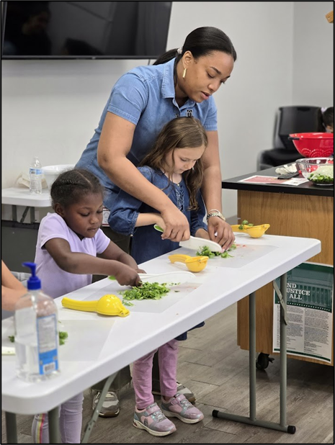
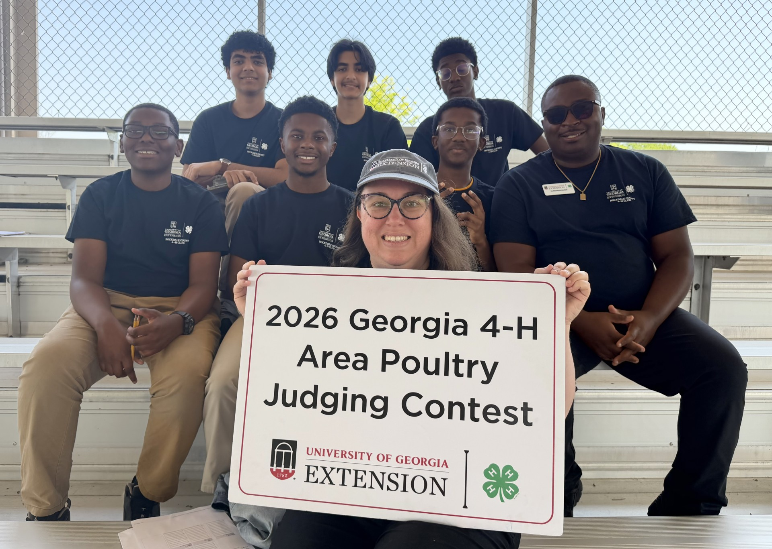


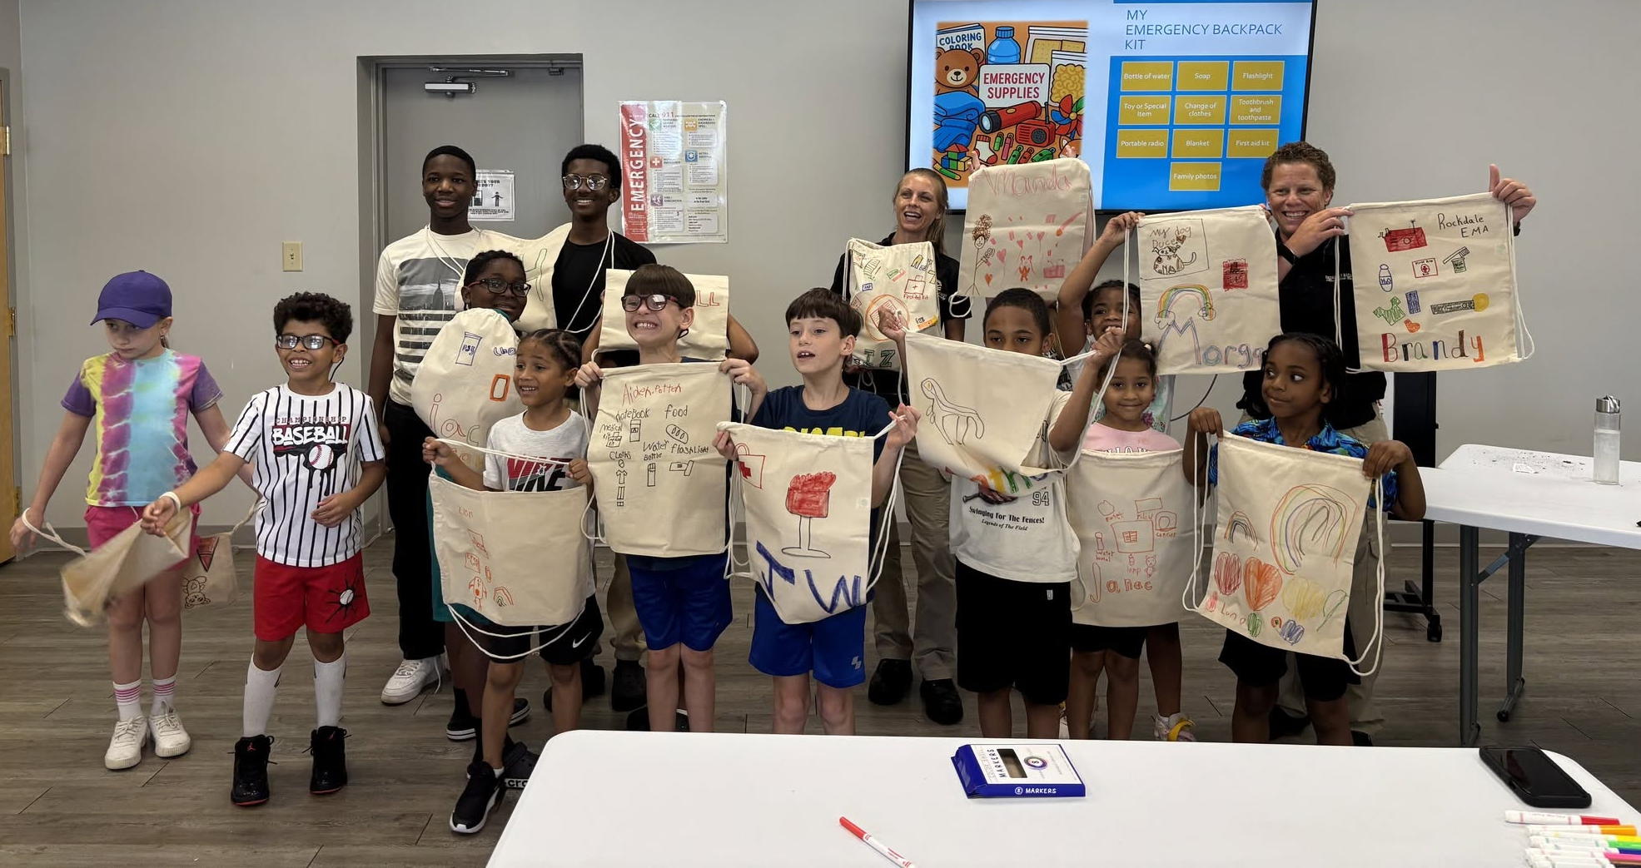
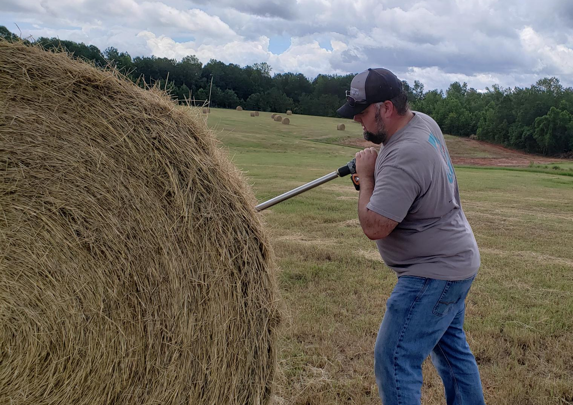
Thank You

