Slide 1

Clerk of Superior and State Courts
2027 OPERATING AND 5-YEAR CIP BUDGET PRESENTATION
FY27 - Budget Request
Presenter: Janice Morris, Clerk of Courts
Date: August 2026

Slide 2
Vision, Mission & Values
Department Statements
    VISION
    THE VISION OF ROCKDALE COUNTY CLERK OF SUPERIOR AND STATE COURTS IS TO PROVIDE RESPONSIVE AND FAIR SERVICES TO A DIVERSE COMMUNITY DELIVERED BY A TEAM OF DEDICATED EMPLOYEES WHO ARE APPROACHABLE, ACCESSIBLE, AND ACCOUNTABLE STEWARDS OF THE COURTS.
Clerk of
Superior and State
Courts
MISSION
  THE ROCKDALE COUNTY CLERK OF SUPERIOR AND STATE COURTS MISSION IS TO SERVE ALL CITIZENS OF ROCKDALE WITH EFFICIENT AND EFFECTIVE STELLAR CUSTOMER AND PUBLIC SERVICE. ALL WHILE MAINTAINING AND PRESERVING COURT RECORDS, FOSTERING THE PUBLIC’S TRUST, AND PROVIDING GUIDANCE TO THE JUDICIAL PROCESS.

Slide 3
Opportunities & Challenges
SUCCESSES
OPPORTUNITIES
CHALLENGES
Completed hybrid online and in person Notary training for 300 citizens.
Well attended Law Library speaker series on relevant legal topics.
Restored and protected historical Deeds and Military discharge books.
Look into AI software to assist with the E-File case load.
Remote deposit of checks into bank accounts.
ACH payments to attorneys for Garnishment cases.
Relocating to unknown location
Continued accessibility to courts and records

Slide 4
FY27 Goals & Initiatives
Department’s Reimagine Rockdale Strategic Plan
Access
Completion of Courthouse in 2027
Equity
Innovation

Slide 5
Operating Budget Summary
*Report Provided by Finance
 | Budget FY 2026 | Proposed FY 2027 | Change
Total Operating Expenses | $861,470.00 | $861,470.00 | $0.00
Total Personnel Services & Benefits | $2,189,202.57 | $2,189,202.57 | $0.00
Total Est. Budget impact | $3,050,672,57 | $3,050,672.57 | $0.00

Slide 6
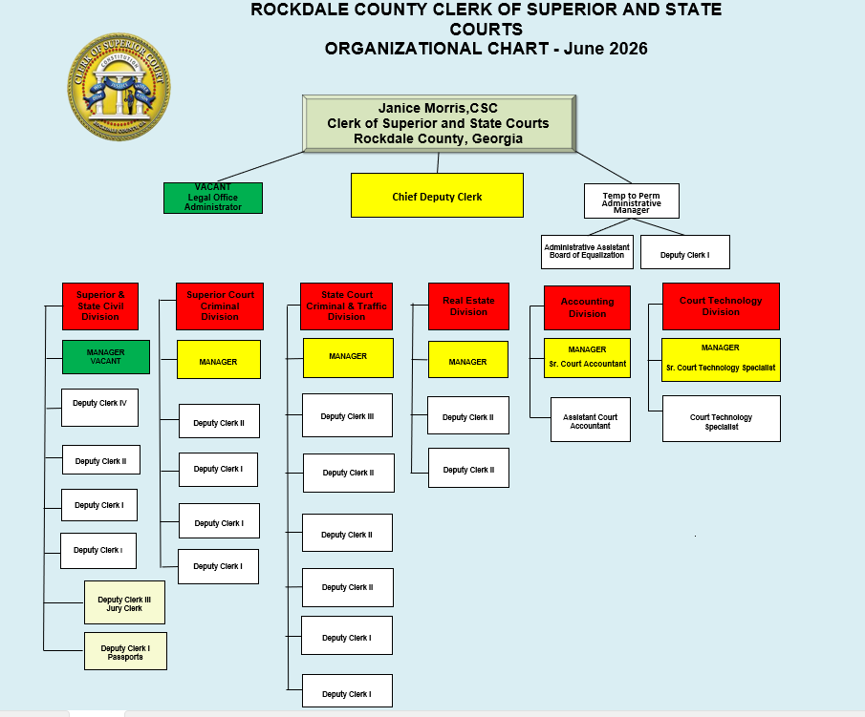
Current Organization Chart
Fiscal Year 2026
Vacancies:
Legal Office Administrator
Civil Division Manager

Slide 7


Thank You

