Slide 1

EMERGENCY MANAGEMENT AGENCY
2027 OPERATING AND 5-YEAR CIP
BUDGET PRESENTATION
FY27 - Budget Request
Presenter: Account/Contract Specialist, NOEMI HAYS
Date: August 4th, 2026

Slide 2
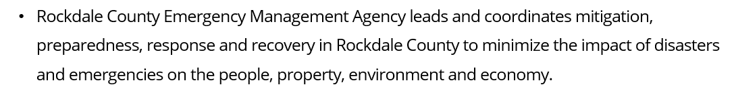

Vision, Mission & Values
Department Statements
    VISION
EMERGENCY MANAGEMENT AGENCY
    MISSION
    VALUES

Slide 3
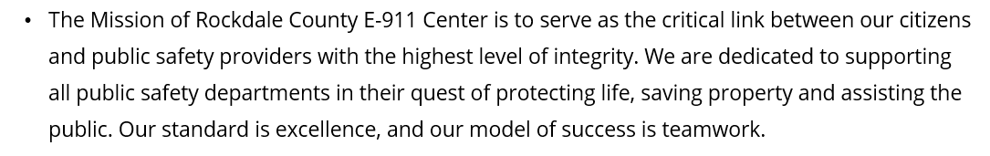

Vision, Mission & Values
Department Statements
    VISION
E911
COMMUNICATIONS
    MISSION
    VALUES

Slide 4
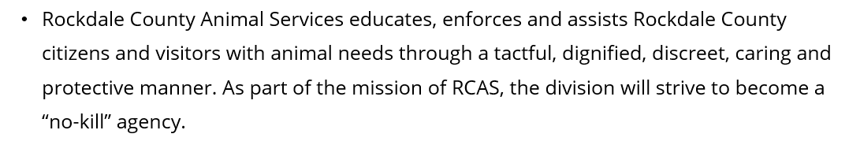
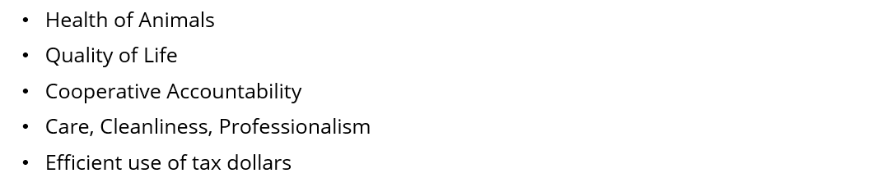
Vision, Mission & Values
Department Statements
    VISION
    MISSION
ANIMAL SERVICES
    VALUES

Slide 5
Opportunities & Challenges
SUCCESSES
OPPORTUNITIES
CHALLENGES
EMA – (9) Weather Sirens fully operational
EMA – Internal & External training exercises
EMA – Active LEPC
EMA – Installed AEDs in County parks W/ Stop the Bleeds Kits
EMA – Preparedness Day event
EMA – Established / enhanced programs
EMA – Virtual JIC established
911 – Implementation of Priority Dispatch EFD and EPD Protocols
911 – Implementation of PowerDMS
911 – Development of a structured QA program
911 – Filled Training Coordinator position
AS – Over $10,000 in supplies/items donated through partnerships
AS – "No Kill" since July 2024
AS – Increased attendance for community events, off-site adoptions, and public outreach
AS – Volunteer Coordinator & Kennel Assistants
RM- Safety National Training Partnership
RM- ACCG Safety Grant- $8500
RM- Department Safety Ambassadors
RM- Safety Coaching Sessions
EMA – Identify additional emergency shelters/ POD locations
EMA – Identify location for a community storm shelter
EMA – Outreach events to target vulnerable areas
EMA – Continue to grow CERT program
EMA – Cross-train personnel
EMA – Additional training (GEMA, FEMA) for county employees
EMA – Career growth
EMA – 2nd Annual National Preparedness Day event
911 – Career growth (In-house promotions)
911 – Community Outreach
911 – Increase training opportunities
AS – Ordinance updates to reduce animal intake
AS – Offer community resources and Return to Owner in the
field (RTOF) programs to reduce animal intake
AS – Public education classes, new adoption and volunteer programs, and improved customer service
RM- Safety Training Program
RM- NSC Certification
RM- Monthly Safety Videos w/ PR for County employees
RM- Safety First Grant Program $10K
EMA – Funding
EMA – Citizen participation
EMA – Work/life balance – time vs. Pay
911 – Employee retention
911 – Work life balance and stress management
911 – Mental Health Awareness
AS – Retention of current employees
AS – Addressing generational gaps affecting employee
relations
AS – Short staffed to properly handle the call volume
and programs we want to implement.
AS – Influx of animals due to increase in hours and
current economic state
AS – Shelter space for all operations needed
AS – Public view on animal services that is not accurate
AS – Needed costly kennel repairs
RM- MV Claims Rate/Severity
RM- Pothole Management System
RM- EMR >1.00
RM- Ergonomics
RM- RCSO Claims Management

Slide 6
FY27 Goals & Initiatives
Department’s Reimagine Rockdale Strategic Plan
Access
Mobile pet adoption
Volunteer programs
Equity
Trainings for the community to include preparedness, response, 911, risk management, safety
Innovation
Risk Management safety videos
Stop the Bleed training w/ citizens and RCPS

Slide 7
Operating Budget Summary
*Report Provided by Finance
EMA
 | Budget FY 2026 | Proposed FY 2027 | Change
Total Operating Expenses | $2,264,910 | $2,697,877 *Risk Management – $2,584,716 *EMA - $113,161 | $432,967
Total Personnel Services & Benefits | $674,506 | $703,827 | $29,321
Total Est. Budget impact | $2,939,416 | $3,401,704.59 | $462,288

Slide 8
Operating Budget Summary
*Report Provided by Finance
E911 - COMMUNICATIONS
 | Budget FY 2026 | Proposed FY 2027 | Change
Total Operating Expenses | $991,484 | $995,885 | $4,401
Total Personnel Services & Benefits | $2,092,340 | $2,233,539 | $141,199
Total Est. Budget impact | $3,083,824 | $3,229,424 | $145,600

Slide 9
Operating Budget Summary
*Report Provided by Finance
ANIMAL SERVICES
 | Budget FY 2026 | Proposed FY 2027 | Change
Total Operating Expenses | $203,518 | $233,786 | $30,268
Total Personnel Services & Benefits | $837,946 | $960,660 | $122,714
Total Est. Budget impact | $1,041,464 | $1,194,446 | $152,982

Slide 10
Operating Budget Request
* Include changes of $5,000 or greater only
 | Description | FY26 Budget | FY27 Cost | Amount Change
Professional Services (RM) | Concentra, ACCG IRMA fees | $0 | $32,359 | $32,359
Insurance (RM) | Liability for building coverage | $1,467,192 | $1,900,000 | $432,808
Overtime Needs (911) | 911 OT needs due to short staffing | $100,000 | $120,000 | $20,000
Software (911) | Microsoft Software | $0 | $7,951 | $7,951
Travel (911) | 911 personnel travel for conferences/trainings | $9,720 | $18,720 | $9,000

Slide 11
Operating Budget Request
* Include changes of $5,000 or greater only
 | Description | FY26 Budget | FY27 Cost | Amount Change
Overtime Needs (AS) | Animal Services OT needs due to short staffing | $10,000 | $20,000 | $10,000
Repair & Maintenance (AS) | Kennel Repairs and Building Maintenance/Updates | $16,900 | $29,900 | $13,000
Training (AS) | Animal Services Training | $6,580 | $12,580 | $6,000
Water & Sewer (AS) | Water use increase due to shelter capacity | $5,000 | $10,000 | $5,000
Other Supplies (AS) | Cost for vaccines and medical supplies | $9,000 | $25,000 | $16,000

Slide 12
Operating Budget Request Justification
Requests
Professional Services (RM) $32,359
  Concentra (drug testing) ACCG IRMA fees
  Insurance (RM) $432,808
  Property and liability coverage / RCFR cancer policy
Overtime (911) $20,000
    Overtime increase to cover short staffing
    Software (911) $7,951
    Microsoft software
    Travel (911) $9,000
    Travel for staff to attend 911 conferences/seminars/trainings for enhanced knowledge and skills

Slide 13
Operating Budget Request Justification
Requests
Overtime (AS) $10,000
    Overtime increase to cover short staffing
    Repair & Maintenance (AS) $13,000
    To cover kennel repairs and building updates
    Training (AS) $6,000
    Recertification year / new training for all staff
    Water & Sewer (AS) $5,000
    Increase to cover increasing usage due to kennel capacity
    Other Supplies (AS) $16,000
    To cover cost of vaccines and medical supplies/equipment (new vendor, offset from Professional Services)

Slide 14
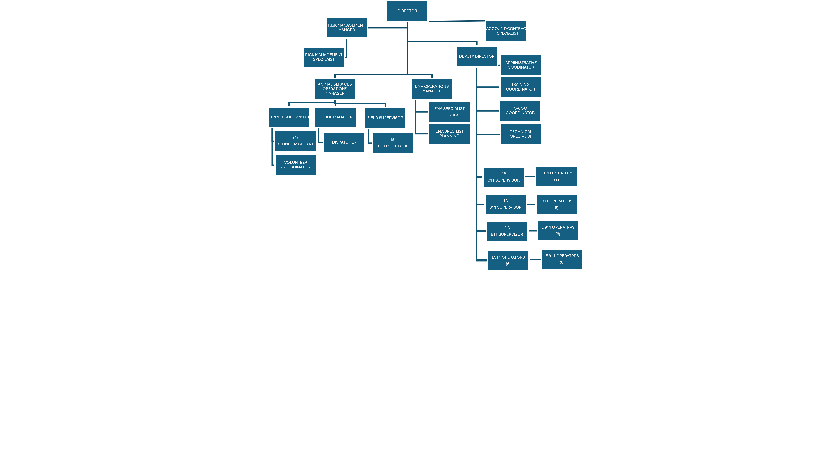
Current Organization Chart
Fiscal Year 2026
Vacancies:
Animal Services - 2
E 911 - 7

Slide 15
5 Year Capital
IMPROVEMENT PLAN
(CIP)
2027-2031
10

Slide 16
Rockdale County (EMA) Five-Year Capital Improvement Plan Fiscal Year 2027-2031
 | 2027 | 2028 | 2029 | 2030 | 2031 | Five Year Total
Automotive Equipment | 170,000.00 | 170,000.00 | 85,000.00 | 85,000.00 |  | 510,000.00
Technology Programs & Improvements | 154,077.00 | 16,013,500.00 |  | 12,000.00 |  | 16,179,577.00
Construction & Heavy Equipment
Building Improvements/Renovations/Expansions | 147,000.00 |  |  |  |  | 147,000.00
New Buildings |  |  | 8,000,000.00 |  |  | 8,000,000.00
Infrastructure Improvements
TOTALS | 471,077.00 | 16,183,500.00 | 8,085,000.00 | 97,000.00 |  | 24,836,577.00
Notes:
16

Slide 17


Thank You

