Slide 1

ROCKDALE FIRE RESCUE
2027 OPERATING AND 5-YEAR CIP
BUDGET PRESENTATION
FY27 - Budget Request
Presenter: Fire Chief James Robinson
Date: August 5, 2026

Slide 2

Vision, Mission & Values
Department Statements
    VISION
  To lead the future of public safety through service, innovation, and unwavering commitment to our community.
    MISSION
  Rockdale County Fire Rescue exists to protect life, property, and the environment through responsive emergency services, progressive risk reduction, and a culture of excellence. We are committed to serving our diverse community with integrity, innovation, and compassion.
    VALUES
Respect
Openness
Commitment
Knowledge
Diversity
Accountability
Leadership
Excellence

Slide 3
Opportunities & Challenges
SUCCESSES
Transparent promotional process
EMT-Advanced Classes
Hazardous Materials Technician Classes
Recruit class graduation – 10 New FF/EMT’s
1 Engine apparatus attained
Enhanced firefighter training and credentialing
Expanded technical rescue capabilities
Increased public education and outreach
Strong fiscal stewardship and budget management
Increased community engagement and public trust
Exceptional service delivery despite staffing shortages
OPPORTUNITIES
Competitive compensation and retention initiatives
Staffing additional frontline companies
Replacement of aging apparatus
Expansion of firefighter wellness and peer support
Training facility – Additional phases
Modernization of fire stations
Increased grant funding opportunities
Succession planning and leadership development
Increased regional collaboration
ISO rating improvement opportunities
Recruitment and Lateral Hiring
Social Media Branding
CHALLENGES
Recruitment and retention of qualified personnel
Non-competitive compensation
Rising apparatus replacement costs
Increasing call volume
Inflation impacting operational costs
Future commercial and residential growth
Maintaining service levels with limited resources
Training – Facility
Long-term capital funding requirements
Aging Fleet
Budget Constraints

Slide 4
FY27 Goals & Initiatives
Department’s Reimagine Rockdale Strategic Plan
Access
Add additional operational personnel to staff two quick response vehicles (QRV’s).
Increase special operation capabilities, including technical rescue, hazardous materials, dive and swift water rescue.
Adjust staffing, apparatus placement, and deployment based on call volume, growth, and risk assessments.
Use train-the-trainer programs to increase in-house instruction to personnel to reduce training cost.
Equity
Establish a formal mentoring program at all ranks.
Increase health and wellness programs for personnel to focus on both mental and physical health.
Increased emphasis on professional and career development for personnel.
Use community risk data to direct prevention and education programs to areas of greatest need.
Innovation
Data-driven metrics for decision-making.
Credentialing for all Ranks.
Implement fleet management technology to track apparatus maintenance, readiness, and safety of personnel.
Preemptive traffic control devices.

Slide 5
Operating Budget Summary
*Report Provided by Finance
 | Budget FY 2026 | Proposed FY 2027 | Change
Total Operating Expenses | $2,233,955 | $2,400,505 | $166,550
Total Personnel Services & Benefits | $15,529,971 | $16,794,189 | $1,264,218
Total Est. Budget impact | $17,763,926 | $19,194,694 | $1,430,768

Slide 6
Operating Budget Request
* Include changes of $5,000 or greater only
 | Description | FY26 Budget | FY27 Cost | Amount Change
Firefighter Physical | Firefighter Annual Medical Physicals as Required by NFPA 1582 13.1 | $0.00 | $64,000 | $64,000
Mental Health Program | Firefighter Mental Health Coaching, Instruction, and Debriefing | $0.00 | $39,000 | $39,000
Building Maintenance | Maintenance of 12 buildings, furniture, beds, etc. | $60,000 | $100,000 | $40,000
Gasoline/Diesel | Fuel for all apparatus and vehicles | $180,404 | $205,404 | $25,000
Natural Gas | Gas for Fire Station Heating and Cooking | $26,922 | $36,922 | $10,000

Slide 7
Operating Budget Request Justification
Requests
Firefighter Physicals $64,000
    NFPA Requires Firefighter physicals annually that are above and beyond what is provided by the insurance company.
    Mental Health Program $39,000
    Personnel need a mental health program that is above and beyond EAP. It should be public safety specific. This is for both treatment and education on mental health.
    Station Repairs $40,000
    Many stations are in disrepair due to funding not being allocated to fix them. To understand the scope RCFR has approximately 10 Stations, 1 Annex, 80 mattresses, 30 Couches, 10 Dishwashers, and 30 Refrigerators.
    Natural Gas $10,000
    Rate increases not controllable by RCFR. Insulation inspections need to be completed of all RCFR Buildings.
    Gas/Diesel $25,000
    Rate increases not controllable by RCFR.

Slide 8
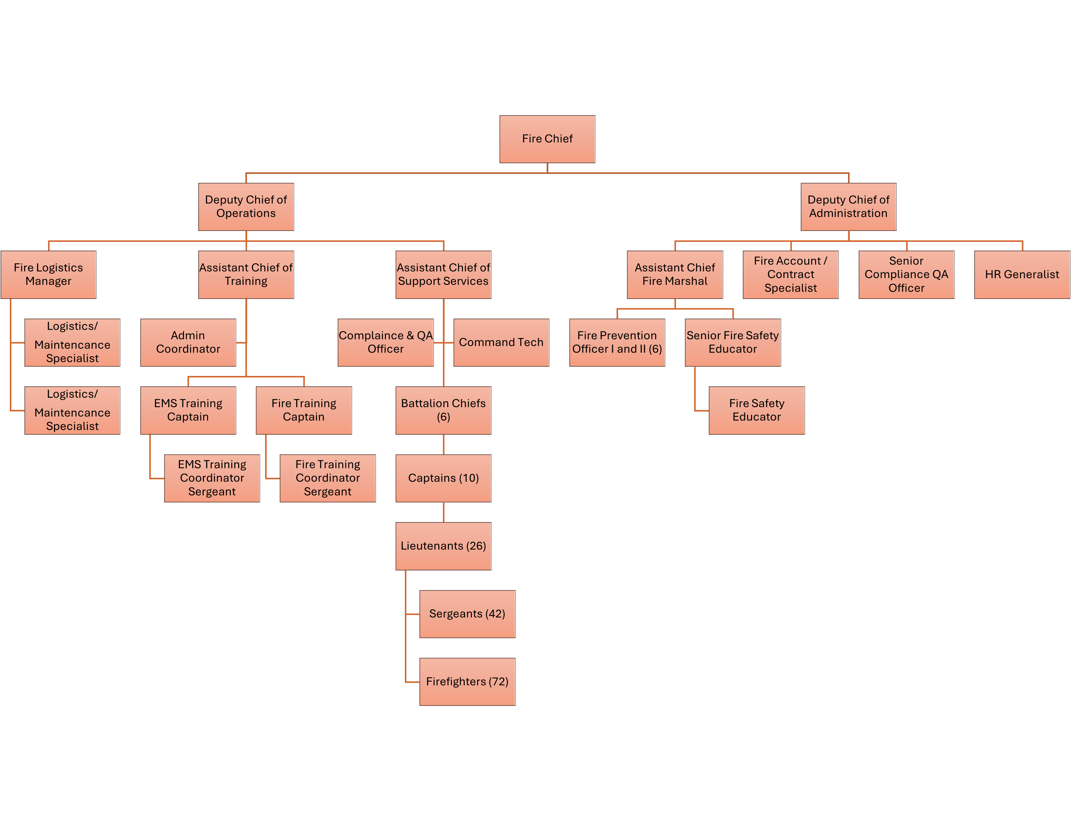
Current Organization Chart
Fiscal Year 2026
Vacancies
(1) Fire Safety Educator
(3) Lieutenants
(5) Sergeants
(11) Firefighters

Slide 9

Proposed Organization Chart
Fiscal Year 2027
Personnel Changes
(6) Lieutenants
(6) Sergeants
(6) Firefighters

Slide 10

Personnel Budget Request
FY26 Budgeted Department Total- 183
FY27 Requested Additional Personnel – 18
Job Title | Fund | Division |  | FTE or PT | Head Count | Request Type | Salary +40% Benefits
Fire Lieutenant | 100 | 3520 |  | FTE | 6 | New Position | $504,310
Fire Sergeant | 100 | 3520 |  | FTE | 6 | New Position | $458,464
Firefighter | 100 | 3520 |  | FTE | 6 | New Position | $405,720
 |  |  |  |  | Total Est. Budget impact |  | $1,368,494
New Department Total (w/Request)- 201
13

Slide 11
Personnel Budget Request Justification
New Position Requests
Fire Lieutenant 6 FTE - $504,310
    Increase the number of personnel on calls to reduce ISO. Enable smaller fire apparatus to respond to low-acuity calls to reduce wear on larger, more expensive apparatus. Fire Lieutenant is the minimum rank to be in charge of all apparatus.
Fire Sergeant 6 FTE - $458,464
    Increase the number of personnel on calls to reduce ISO. Enable smaller fire apparatus to respond to low-acuity calls to reduce wear on larger, more expensive apparatus. Fire Sergeant is the driver/operator of the apparatus.
Firefighter 6 FTE - $405,720
    Increase the number of personnel on calls to reduce ISO. Enable smaller fire apparatus to respond to low-acuity calls to reduce wear on larger, more expensive apparatus. Firefighters are required to complete tasks at scenes.

Slide 12
5 Year Capital
IMPROVEMENT PLAN
(CIP)
2027-2031
10

Slide 13
Rockdale County (Fire Rescue) Five-Year Capital Improvement Plan Fiscal Year 2027-2031
 | 2027 | 2028 | 2029 | 2030 | 2031 | Five Year Total
Automotive Equipment | $57,000 |  |  |  |  | $57,000
Technology Programs & Improvements | $192,676 | $802,676 |  | $52,183 | $49,114 | $1,096,649
Construction & Heavy Equipment | $5,300,000 | $8,300,000 | $3,650,000 | $2,200,000 | $1,100,000 | $20,550,000
Building Improvements/Renovations/Expansions | $47,000 |  |  |  |  | $47,000
New Buildings | $2,600,000 | $4,542,000 |  | $8,000,000 |  | $15,142,000
Infrastructure Improvements
TOTALS | $8,196,676 | $13,644,676 | $3,650,000 | $10,252,183 | $1,149,114 | $36,892,649
Notes:
13

Slide 14

Thank You

