Slide 1

Parks & Recreation
Senior Services
2027 OPERATING AND 5-YEAR CIP
BUDGET PRESENTATION
FY27 - Budget Request
Presenter: Director, Christine Carney
Date: August 4th, 2026

Slide 2

Vision, Mission & Values
Department Statements
    VISION
  To create a vibrant, growing community where a high quality of life is supported by robust commercial growth and an educated workforce.
Parks, Recreation, & Senior Services
    MISSION
Parks & Recreation strives to provide relevant and diverse family, arts and cultural programming while improving our park facilities through upgrades and amenities that attract new and existing citizens, businesses, and tourism.
  Senior Services strives to enhance the quality of life for senior citizens with dedication to serving elderly residents, we work to identify, develop, implement, and coordinate diverse programs and services to address senior citizens’ needs.
    VALUES
Conservation: Protecting open space, connecting children to nature, and engaging communities in conservation practices.
  Health & Wellness: Leading the county to improve health and wellness through parks and recreation.
  Social Equity: Ensuring all people have access to the benefits of local parks and recreation.

Slide 3
Opportunities & Challenges
SUCCESSES
OPPORTUNITIES
CHALLENGES
Expanded Recreation & Senior Services through programs, athletics, camps, wellness, and special events.
Awarded the BOOST Out-of-School Time Grant for the 5th consecutive year.
Completed SPLOST Projects, including the Lawn @ Wheeler Skate Park and Johnson Park Inclusive Playground.
Earned Two GRPA State Awards for the deCastro Trailhead Nature Pavilion and Rockin' Rockdale Summer Concert Series.
Celebrated Athletic Success, winning the 2025–2026 GRPA 14U Class A District 6 & State Championship and hosting the District & State Tournament.
Strengthened Community Partnerships with schools, nonprofits, and professional sports organizations.
Delivered 1,200+ Senior Activities, serving more than 14,000 participants.
Increased Senior Membership Revenue by 9.5% over the entire 2025 total.
Maintained Safe Senior Transportation through 84 vehicle and 4 ASE inspections.
Expand Access through Community Partnerships
Grow Recreation, Wellness & Senior Programs
Improve Services through Innovation & Technology
Increase Revenue through Grants, Sponsorships & Rentals
Invest in Staff Development & Operational Excellence
Limited Personnel Resources
Recruitment & Retention Challenges
Budget Constraints
Growing Community Needs
Aging Infrastructure and Equipment

Slide 4
FY27 Goals & Initiatives
Department’s Reimagine Rockdale Strategic Plan
Access
Maintain safe, accessible, and well-maintained parks and facilities.
Expand recreation programs and services for all ages and interests.
Enhance connectivity through strategic partnerships and community engagement.
Increase awareness of parks, programs, and amenities across the county.
Equity
Ensure recreation opportunities are inclusive, welcoming, and accessible to all.
Reduce barriers to participation through equitable service delivery.
Invest in employee development and foster a culture of accountability.
Strengthen community relationships by listening, engaging, and responding to resident needs.
Innovation
Leverage technology to improve operations and customer experience.
Promote sustainable practices that protect and enhance park resources.
Use data and performance measures to guide strategic decision-making.
Strengthen financial sustainability through grants, partnerships, and operational efficiencies.

Slide 5
Operating Budget Summary
*Report Provided by Finance
 | Budget FY 2026 | Proposed FY 2027 | Change
Total Operating Expenses | $1,951,413 | $1,807,480 | -$143,943
Total Personnel Services & Benefits | $4,507,144 | $4,909,107 | $462,485
Total Est. Budget impact | $6,458,557 | $6,716,587 | $318,552

Slide 6
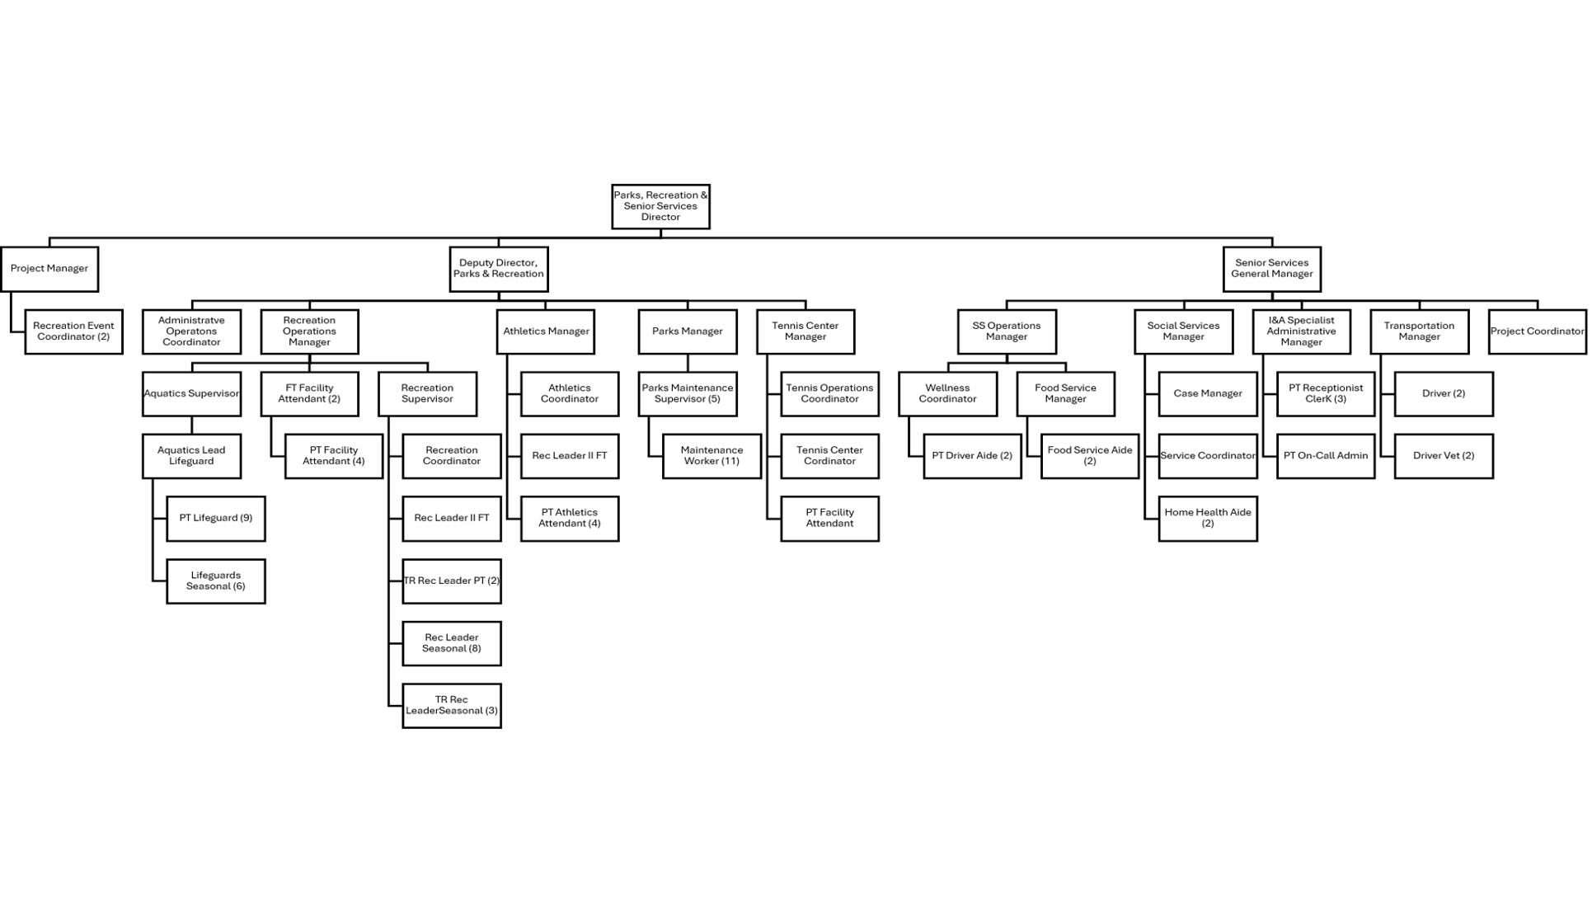
Current Organization Chart
Fiscal Year 2026
Vacancies 4

Slide 7

Proposed Organization Chart
No Personnel Changes
Fiscal Year 2027

Slide 8

Personnel Budget Request
FY26 Budgeted Department Total- 99
FY27 Requested Additional Personnel – 0
Job Title | Fund | Division |  | FTE or PT | Head Count | Request Type | Salary +40% Benefits
N/A |  | N/A |  |  |  |  | $0.00
 |  |  |  |  | Total Est. Budget impact |  | $0.00
New Department Total (w/Request)- 99
13

Slide 9
5 Year Capital
IMPROVEMENT PLAN
(CIP)
2027-2031
10

Slide 10
Rockdale County Parks and Recreation, Senior Services) Five-Year Capital Improvement Plan Fiscal Year 2027-2031
 | 2027 | 2028 | 2029 | 2030 | 2031 | Five-Year Total
Automotive Equipment | $250,894 | $50,000 | $50,000 | $100,000 | $85,000 | $535,894
Technology Programs & Improvements | $59,749 | $0.00 | $9,300 | $6,500 | $150,000 | $225,549
Construction & Heavy Equipment | $0.00 | $0.00 | $0.00 | $0.00 | $0.00 | $0.00
Building Improvements/Renovations/Expansions | $16,500 | $18,000 | $28,000 | $8,000 | $0.00 | $70,500
New Buildings | $0.00 | $0.00 | $0.00 | $0.00 | $0.00 | $0.00
Infrastructure Improvements | $0.00 | $0.00 | $0.00 | $0.00 | $0.00 | $0.00
TOTALS | $327,143 | $68,000 | $87,300 | $114,500 | $235,000 | $831,943
Notes:
10

Slide 11

Thank You

