Slide 1

THE LAW OFFICE OF THE ROCKDALE CIRCUIT PUBLIC DEFENDER
2027 OPERATING AND 5-YEAR CIP
BUDGET PRESENTATION
FY27 - Budget Request
Presenter: Director, GINA BERNARD, CPD
Date: August 5, 2026

Slide 2
Vision, Mission & Values
Department Statements
    VISION
    The Law Office of the Rockdale Circuit Public Defender consists of a team of qualified, experienced, talented, attorneys, investigators, paralegals, and administrative staff who are client focused and results oriented.
    MISSION
    Ensure the indigent citizens of Rockdale County charged in the criminal justice system, receive effective, zealous, client-focused legal representation from arrest through trial and appeal, in keeping with the protections of the U.S. and Georgia Constitutions.
PUBLIC DEFENDER
    VALUES
    Professional, courteous, client-focused, dedicated to indigent defense,
    dependable and reliable.

Slide 3
Opportunities & Challenges
SUCCESSES
Receptionist added
Social Worker added
Part Time Attorney added
OPPORTUNITIES
Active outreach @ law schools within and outside Georgia
UGA Law internship & fellowship programs
CHALLENGES
Ongoing statewide shortage of qualified attorneys with Georgia’s court system
Overall recruitment is more challenging & time-consuming

Slide 4
FY27 Goals & Initiatives
Department’s Reimagine Rockdale Strategic Plan
Access - Ensuring that all individuals in the Rockdale County Jail have counsel.
Equity – Focus on rehabilitating clients to become positive contributors to the community.
Innovation – Using technology to ensure more efficient and effective representation for all.

Slide 5
Operating Budget Summary
*Report Provided by Finance
 | Budget FY 2026 | Proposed FY 2027 | Change
Total Operating Expenses | $104,804 | $111,804 | $7,000
Total Personnel Services & Benefits | $1,012,597 | $1,296,817 | $284,220
Total Est. Budget impact | $1,117,401 | $1,408,621 | $291,220

Slide 6
Operating Budget Request
* Include changes of $5,000 or greater only
 | Description | FY26 Budget | FY27 Cost | Amount Change

Slide 7
Operating Budget Request Justification
Requests

Slide 8
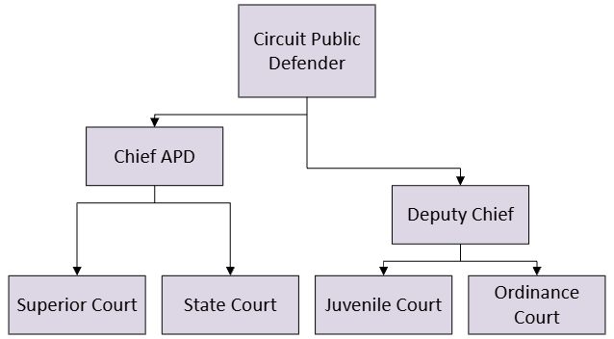
Vacancies
APD 3 (2 openings)
APD 2 (1 opening)
APD 1 (2 openings)
Current Organization Chart
Fiscal Year 2026

Slide 9
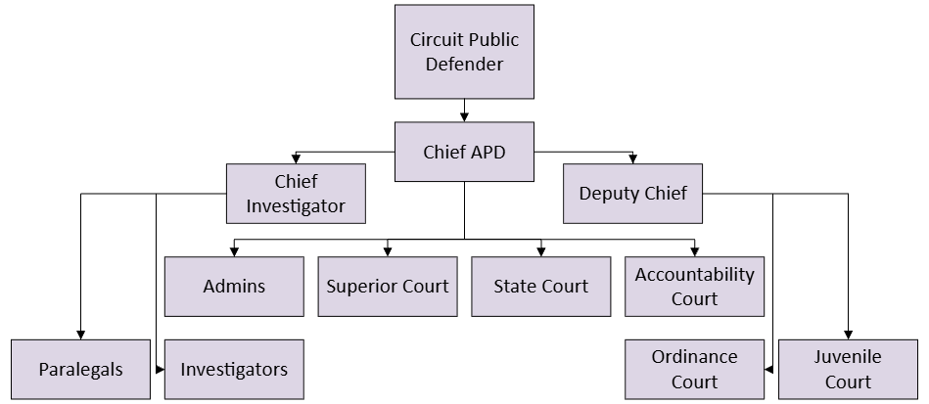
Proposed Organization Chart
Fiscal Year 2027
Personnel Changes

Slide 10

Personnel Budget Request
FY 26 Budgeted Department Total-10
FY27 Requested Additional Personnel –15
Job Title | Fund | Division |  | FTE or PT | Head Count | Request Type | Salary +40% Benefits
Assistant Public Defender III | 100 | 2800 |  | FTE | 2 | New Position | $308,000
Assistant Public Defender II | 100 | 2800 |  | FTE | 6 | New Position | $980,000
Paralegals | 100 | 2800 |  | FTE | 4 | New Position | $340,228
Investigators | 100 | 2800 |  | FTE | 3 | New Position | $302,400
 |  |  |  |  | Total Est. Budget impact |  | $1,930,628
New Department Total (w/Request)- 25
13

Slide 11
Personnel Budget Request Justification
New Position Requests
8 Attorneys $1,288,000
    Experienced Superior Court attorneys trained in homicide and sex crime cases as that caseload has increased, and 2 trial ready line attorneys per Superior, Juvenile & State Court Judge and attorneys for Ordinance & Accountability Courts.
    3 Investigators $302,400
    Experienced criminal defense investigators for the Homicide & Sex Crime Unit per Superior Court Judge, as well as for Juvenile, State & Ordinance Court
    4 Paralegals $340,288
    Experienced criminal defense paralegals for Superior, Juvenile & State Courts.

Slide 12
5 Year Capital
IMPROVEMENT PLAN
(CIP)
2027-2031
10

Slide 13
Rockdale County (Public Defender) Five-Year Capital Improvement Plan Fiscal Year 2027-2031
 | 2027 | 2028 | 2029 | 2030 | 2031 | Five Year Total
Automotive Equipment | 50,000 |  |  |  |  | 50,000
Technology Programs & Improvements
Construction & Heavy Equipment
Building Improvements/Renovations/Expansions
New Buildings
Infrastructure Improvements
TOTALS | 50,000 |  |  |  |  | 50,000
Notes:
13

Slide 14

Thank You

