Slide 1


Rockdale County
Sheriff’s Office
2027 Operating and 5-Year CIP Budget Presentation
FY27 – Budget Requests
Presenter: Sheriff, Eric J. Levett
Date: August 2026

Slide 2


Vision, Mission & Values
Rockdale County Sheriff’s Office
    VISION
  The VISION of the Rockdale County Sheriff’s Office is to continue to be a leader in law enforcement. The vision will continue to focus on FOUR PILLARS, which are: Accountability, Administrative Efficiency, Communication Internally and External Communications.
    MISSION
Rockdale County Sheriff’s Office
  To reduce crime, safely house inmates, bring offenders to justice, and perform the mandated services of the Office of Sheriff with the highest level of safety, professionalism, and integrity.
    VALUES
  Crime Reduction
  Technology& Equipment
  Professional Development, Hiring & Retention

Slide 3

Opportunities & Challenges
SUCCESSES
CHALLENGES
The Finance Unit reduced the 2026 budget deficit by streamlining financial processes to stabilize budget usage.
The Rockdale County Jail achieved ACA Accreditation and passed the ACA Audit with 100% compliance on all standards, along with successfully attaining NCCHC accreditation.
To address staff shortages, Judicial Services implemented innovative strategies, including a civil paper notification process that has increased the number of papers served.
Support Services personnel collaborated with the Jail Division to prepare for the ACA inspection, resulting in a successful outcome.
Key achievements include acquiring a Cellebrite computer to enhance digital investigations, partnering with USPS to combat narcotics trafficking, and launching a recruitment program to strengthen the Criminal Investigation Division.
The Rockdale County Jail has faced personnel shortages but continues to operate safely.
The Warrant/Civil Department is struggling to manage a high volume of legal documents with only two deputies, resulting in an overwhelming workload and significant operational bottlenecks.
The RCSO fleet is aging, with 85% of vehicles over 100,000 miles. The fleet manager has developed a plan for annual vehicle updates.
The CID is challenged by heavy caseloads and limited resources, making thorough casework difficult. Attracting qualified investigators is also a challenge due to entry-level salaries that are 16% below neighboring jurisdictions, increasing workloads and negatively impacting morale and investigation quality
OPPORTUNITIES
The Rockdale County Jail has promoted health and wellness among detention staff while developing leadership skills in supervisors and training the next level of supervisors to take over day-to-day command.
Collaboration with the RCSO SPLOST Committee has secured funding to update aging fleet vehicles.
The opportunity to establish a state-of-the-art Forensic Data Center with updated equipment and software (such as Cellebrite Premium and Accurint System) will significantly improve CID’s crime analysis, crime-solving, and investigative efficiency.
Equipping investigators with mobile printers allows for the drafting and printing of warrants in the field, reducing the need to return to headquarters and speeding up operational processes.

Slide 4

FY27 Goals & Initiatives
Department’s Reimagine Rockdale Strategic Plan
Access: We are dedicated to enhancing community engagement through ongoing accessible communication and outreach programs within the Sheriff's Office. Our goal is to ensure all citizens can easily report concerns and receive updates on public safety initiatives, fostering open dialogue and keeping the community informed about their safety.
Equity: We are committed to enhancing fairness in law enforcement practices through our ongoing strategic plan, which includes implementing bias training for all personnel. This ensures that every community member is treated with respect and dignity, regardless of their background.
Innovation: Our goal is to leverage advanced technology agency-wide to enhance operations especially in the Jail Bureau and Judicial Services. This initiative includes implementing a digital case management to improve efficiency and transparency in inmate processing, as well as in civil and warrants processes.

Slide 5
Operating Budget Summary
*Report Provided by Finance
 | Budget FY 2026 | Proposed FY 2027 | Change
Total Operating Expenses | $9,249,102 | $10,286,077 | $1,036,975
Total Personnel Services & Benefits | $25,260,693 | $30,633,608 | $5,372,915
Total Est. Budget impact | $34,509,795 | $40,919,685 | $6,409,890

Slide 6
Operating Budget Request (LE Admin: 3310)
* Include changes of $5,000 or greater only
 | Description | FY26 Budget | FY27 Cost | Amount Change
3310-521200 | An increase in funding for lawn services is necessary due to limited staffing and available detail workers, ensuring the Sheriff’s Office grounds are properly maintained. | $54,000 | $60,000 | $6,000
3310-523500 | Additional funding is also needed to cover rising travel costs for training, supporting over 21 administrative personnel , the agency’s Mental Health & Wellness services for RCSO staff and the Chaplains that are responsible for attending annual training. | $40,000 | $60,952 | $20,952
3310-523700 | Furthermore, we require more funding for the LE Admin staff to cover training costs for the Peer Support and Women’s Leadership programs, which will also act as a backup for other divisions when their budgets are low. | $20,000 | $31,952 | $11,952

Slide 7
Operating Budget Request Justification
(LE Admin: 3310)
Requests
3310-521200 (Professional Services) $6,000
    An increase in funding for lawn services is necessary to ensure that the grounds of the Sheriff’s Office are properly maintained, especially given the limited staffing and available detail workers.
    3310-523500 (Travel) $20,952
    An increase is required to accommodate the rising travel costs associated with training needs. This budget supports over 21 administrative personnel for the entire year and will also cover travel expenses for the agency’s Mental Health & Wellness services for RCSO personnel as well as our Chaplain's training.
    3310-523700 (Education & Training) $11,952
    Additional funding is needed to support the Law Enforcement Administration staff and cover training costs for the Peer Support and Women’s Leadership programs, which fall under the LE Admin Division's responsibilities. This funding will also serve as a backup source for other divisions when their budgets are low.

Slide 8
Operating Budget Request
(Sheriff’s Office & Buildings: 3355)
* Include changes of $5,000 or greater only
 | Description | FY26 Budget | FY27 Cost | Amount Change
3355-522200 | Repair and maintenance funds to support two major RCSO operational buildings (Headquarters and Southside Precinct) | $70,682 | $80,682 | $10,000

Slide 9
Operating Budget Request Justification
(Sheriff’s Office & Buildings: 3355)
Requests
    3355-522200 $10,000
    Funding for the repair and maintenance of the Sheriff's Office and its facilities is essential, as these locations support Headquarters and the Southside Precinct, while also serving as backups for other agency buildings. Adequate maintenance is crucial for ensuring operational readiness, safety, and efficiency throughout all divisions.

Slide 10
Operating Budget Request (UPD: 3323)
* Include changes of $5,000 or greater only
 | Description | FY26 Budget | FY27 Cost | Amount Change
3323-523500 | We are requesting additional funding to meet UPD's increased travel needs for training specialized units. These units have not received adequate funding to operate effectively. Support is needed for the SWAT Unit, K-9 Unit, Motors Unit, Traffic Unit, SRO Unit, and COPS operations, all of which are crucial to the agency and the community. | $11,000 | $16,000 | $5,000

Slide 11
Operating Budget Request Justification
(Uniform Patrol Division: 3323)
Requests
3323-523500 (Travel) $5,000
    We are seeking additional funding to support UPD's increased travel needs for the training of specialized units. Unfortunately, these units have not received adequate resources to operate effectively. We request support for the SWAT Unit, K-9 Unit, Motors Unit, Traffic Unit, SRO Unit, and COPS operations, all of which are vital to both the agency and the community.

Slide 12
Operating Budget Request (SSD: 3350)
* Include changes of $5,000 or greater only
 | Description | FY26 Budget | FY27 Cost | Amount Change
3350-521200 | The costs for RCSO's technological software and annual maintenance agreements, particularly the Axon contract, have increased significantly. Adequate funding is necessary to accommodate these budgetary changes. | $878,846 | $1,267,970 | $389,124
3350-522200 | Funding for repair and maintenance is essential to keep equipment and facilities in optimal condition under the oversight of Support Services. Additionally, resources are needed for the upkeep of the mobile command vehicle and older vehicles. | $40,000 | $180,000 | $140,000

Slide 13
Operating Budget Request Justification
(Support Services Division: 3350)
Requests
3350-521200 (Professional Services) $389,124
    There is a notable price increase for RCSO's technological software and annual maintenance agreements, particularly concerning the Axon contract.
    3350-522200 (Repair & Maintenance) $140,000
    The Support Service Division requires additional funding for repair and maintenance to ensure that equipment and facilities remain in optimal condition. This funding will address aging infrastructure and necessary upgrades, ultimately improving the division's efficiency in serving the community and operating the mobile command vehicle.

Slide 14
Operating Budget Request (CID: 3320)
* Include changes of $5,000 or greater only
 | Description | FY26 Budget | FY27 Cost | Amount Change
3320-523500 | Increase needed to support ongoing rise in travel cost for training needs. This budget supports over 15 CID investigators for the entire year. | $13,000 | $18,000 | $5,000

Slide 15
Operating Budget Request Justification
(CID: 3320)
Requests
3320-523500 $5,000
    Increase to support ongoing raise in travel cost for advanced and continuous training for Investigators.

Slide 16
Operating Budget Request
(Judicial Services: 3360)
* Include changes of $5,000 or greater only
 | Description | FY26 Budget | FY27 Cost | Amount Change
3360-521300 | Increase to support out of state extradition cost that have risen. | $31,941 | $39,941 | $8,000
3360-523500 | Increase in the Travel Line-item | $13,000 | $18,000 | $5,000
3360-523700 | Increase funded for adequate training for Deputies and the increase in added Courthouse Deputies for new courthouse | $5,000 | $10,000 | $5,000
3360-531600 | Funding to support additional ballistic shields and less-lethal weapons for added Courthouse Deputies for opening of new courthouse. | $13,622 | $20,622 | $7,000

Slide 17
Operating Budget Request Justification
(Judicial Services: 3360)
Requests
3360-521300 (Technical Services) $8,000
    RCSO seeks additional funding to support the safe apprehension of out-of-state fugitives.
    3360-523500 (Travel) $5,000
    Adjustments to the travel budget are necessary due to increased personnel assigned to the Courthouse, ensuring sufficient funds for travel expenses.
    3360-523700 (Education & Training) $5,000
    With 43 authorized employees, the current training budget is insufficient. An increase is requested to ensure proper training, especially with the new courthouse opening.
    3360-531600 (Small Equipment) $7,000
    Funding is needed for ballistic shields, less-lethal weapons, and maintenance of panic buttons for safety in the new courthouse.

Slide 18
Operating Budget Request (Jail: 3326)
* Include changes of $5,000 or greater only
 | Description | FY26 Budget | FY27 Cost | Amount Change
3326-521200 | Jail Inmate Medical Services | $4,040,333 | $4,308,705 | $268,372
3326-522200 | Increase for repairs and maintenance of the jail. | $322,765 | $362,765 | $40,000
3326-523500 | Increase needed to support ongoing rise in travel cost for training needs. This budget supports over 100 Jail personnel for the entire year. | $13,000 | $20,000 | $7,000
3326-523700 | Increase for training cost for jail personnel | $24,924 | $29,924 | $5,000

Slide 19
Operating Budget Request (Jail: 3326)
* Include changes of $5,000 or greater only
 | Description | FY26 Budget | FY27 Cost | Amount Change
3326-531100 | Need for additional general supplies in preparation for the opening of the Mental Health Unit. | $60,000 | $65,000 | $5,000
3326-531210 | Water and Sewer for RCSO Jail | $240,861 | $245,861 | $5,000
3326-531220 | Natural Gas for RCSO Jail | $45,014 | $55,014 | $10,000
3326-531230 | Electricity for RCSO Jail | $433,819 | $443,819 | $10,000
3326-531300 | Jail Inmate Food Services | $738,340 | $756,017 | $17,677
3326-531600 | Small Equipment Purchases for the Jail | $32,335 | $40,335 | $8,000

Slide 20
Operating Budget Request Justification
(Jail: 3326)
Requests
3326-521200 (Professional Services) $268,372
    Increase to support rise in inmate medical services.
    3326-522200 (Repair & Maintenance) $40,000
    Increase for repairs and maintenance of repairs in women’s jail annex, ongoing jail repairs and upkeep and vehicle cost.
    3326-523500 (Travel) $7,000
    Increase to support ongoing raise in travel cost for advanced and continuous training for Jail Deputies.
    3326-523700 (Education & Training) $5,000
    Increase to support ongoing raise in travel cost for advanced and continuous training for Jail Deputies.
    3326-531100 (General Supplies) $5,000
    Increase needed to support rise of supplies/materials due to inflation cost provided by companies being used.

Slide 21
Operating Budget Request Justification
(Jail: 3326)
Requests
    3326-531210 (Water & Sewer) $5,000
    Increase needed to support ongoing rise in jail’s water and sewer utility cost.
    3326-531220 (Natural Gas) $5,000
    Increase needed to support ongoing rise in jail’s natural gas utility cost.
    3326-531230 (Electricity) $10,000
    Increase needed to support ongoing rise in jail’s electricity utility cost.
    3326-531300 (Food Services) $17,677
    Additional funding to support the rise of food cost for inmate food services.
    3326-531600 (Small Equipment) $8,000
    The Rockdale County Sheriff’s Office no longer has grant funding for ballistic and stab vests for our employees, which were previously covered for several years. We request that the County allocate additional funding in the small equipment line item to ensure our personnel can work safely and return home to their families.

Slide 22
Proposed Organization Chart
Fiscal Year 2027
Personnel Changes
SO Authorized: 348
Requested Positions: 26
Chart Pending

Slide 23
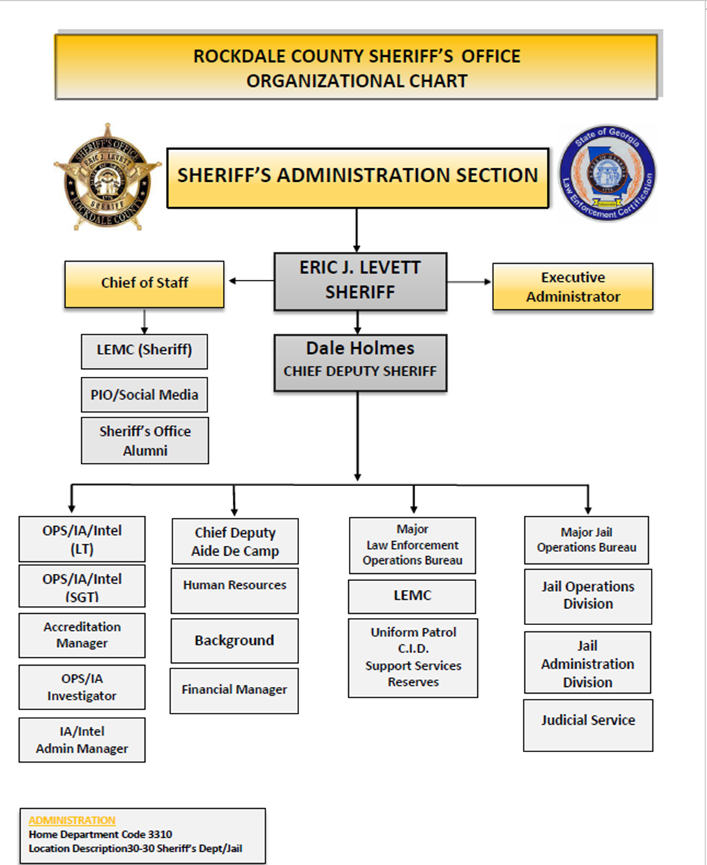
Current Organization Chart
Fiscal Year 2026
Vacancies: 67

Slide 24
Personnel Budget Request (Part 1)
FY26 Budgeted Department Total- 348
FY27 Requested Additional Personnel – 26
Job Title | Fund | Division | FTE or PT | Head Count | Request Type | Salary +40% Benefits
HR Generalist | 3310 | LE Admin | FTE | 1 | New Position | $71,052.80
Fiscal Officer | 3310 | LE Admin | FTE | 1 | New Position | $71,048.68
Social Media Specialist | 3310 | LE Admin | FTE | 1 | New Position | $66,306.24
Accreditation Specialist | 3310 | LE Admin | FTE | 1 | New Position | $60,132.80
Forensic Analyst | 3320 | CID | FTE | 1 | New Position | $71,052.80
Accident Investigators | 3323 | UPD | FTE | 3 | New Position | $241,375.68
Property Evidence Technician | 3350 | SSD | FTE | 1 | New Position | $56,201.60
Administrative Manager | 3326 | Jail | FTE | 1 | New Position | $71,052.80
 |  |  |  | Total Est. Budget impact |  | $ 708,223.40

Slide 25
Personnel Budget Request (Part 2)
Job Title | Fund | Division | FTE or PT | Head Count | Request Type | Salary +40% Benefits
System Analyst | 3350 | Support Services | FTE | 1 | New Position | $66,306.24
Certified Deputies | 3360 | Judicial (Civil & Warrants) | FTE | 2 | New Position | $148,919.68
Certified Deputies | 3360 | Judicial (New Courthouse) | FTE | 12 | New Position | $893,518.08
Sergeant | 3360 | Judicial (New Courthouse) | FTE | 1 | New Position | $87,913.28
 |  |  |  | Total Est. Budget impact |  | $1,196,657.28
New Department Total (w/Request)- $1,904,880.68

Slide 26

Personnel Budget Request Justification
New Position Requests
HR Generalist (LE Admin) 1 FTE - $71,052.80
Adding an HR Generalist to the RCSO HR Unit is essential to manage the growing workload effectively. This role will improve operational efficiency by supporting recruitment, employee relations, and compliance tasks, allowing current staff to focus on strategic initiatives. With a dedicated HR Generalist, we can enhance service delivery, reduce response times, and streamline HR processes, fostering a more engaged workforce.
Fiscal Officer (LE Admin) 1 FTE - $71,048.68
This full-time position will perform accounting-related clerical duties that require familiarity with basic accounting functions and grant management duties. As the Fiscal Officer I, this person will perform various administrative and technical work involving many different and unrelated processes, methods, and deadlines. Duties involve accurately recording and reporting accounting-related and financial transactions for the Rockdale County Sheriff’s Office. As Fiscal Officer I, you may be responsible for Grant Management, Accounts Receivables, Accounts Payables, Purchasing and Procurement, and Cash Management.
Social Media Marketing Specialist (LE Admin) 1 FTE - $66,306.24
The Social Media Marketing Specialist will oversee the Sheriff’s Office online presence by creating engaging content, managing social media communities, and analyzes performance. This position builds the Sheriff’s Office brand awareness, drives audience engagement, and adapts strategies to evolving digital trends. It shifts social media into a measurable, strategic asset, expanding reach and amplifies recruiting efforts while providing transparent information as a reliable source for the public.
Accreditation Specialist (LE Admin) 1 FTE - $60,132.80
The Rockdale County Sheriff’s Office is pursuing an Accreditation Specialist, which requires agency compliance with state standards for facilities and CALEA accreditation requirements. This position will necessitate additional personnel to implement new operational procedures for accountability, resource-management and overall standard practices.

Slide 27
Personnel Budget Request Justification
New Position Requests
Forensic Crime Analyst (CID) 1 FTE – $71,052.80
The Forensic Crime Analyst position is vital for supporting investigations by providing timely and accurate analysis of digital evidence. With increasing case volumes and the growing complexity of cyber-related crimes, there is a critical need for specialized expertise to recover, process, and interpret digital data from devices such as computers and cellphones. Having a dedicated analyst ensures that evidence is handled securely and efficiently, accelerating case resolution and supporting successful prosecutions. This role not only improves investigative outcomes but also helps maintain high professional standards and the integrity of the forensic process.
Accident Investigators (UPD) 3 FTE – $241,375.68
Rockdale County's traffic has surged due to population growth, requiring expansions on roads like Highway 138 and Salem Road. This increase in vehicles has led to more crashes and hit-and-run incidents. The Rockdale County Sheriff's Office Traffic Unit, with only three deputies, handles investigations of fatal accidents, serious injuries, and traffic enforcement. This is a specialized position that requires skilled expertise from experience certified deputies who can investigate minor, serious, or fatal motor vehicle crashes in Rockdale County by conducting adequate and thorough investigations as expected by our community.
Property Evidence Technician (Support Services) 1 FTE - $56,201.60
SSD currently has two property and evidence technicians, Due to an overwhelming number of open records requests for body camera footage one of the technicians currently must spend most of their time on this task. SSD can use this position to help with the massive of amount of property and evidence turned in by deputies.

Slide 28
Personnel Budget Request Justification
New Position Requests
Administrative Manager (Jail) 1 FTE - $71,052.80
The Major overseeing the Jail Bureau needs an assistant to handle administrative tasks. An assistant is essential for effective management within the Sheriff’s Office. The Admin Manager will serve as the Assistant to the Jail Bureau Major who would be responsible for the management of all projects within the Jail Bureau (Jail and Judicial), handling all administrative tasks for the bureau, attending meetings for the Major, etc.
System Analyst (Support Services) 1 FTE - $66,306.24
The Major overseeing the Jail Bureau needs an assistant to handle administrative tasks. An assistant is essential for effective management within the Sheriff’s Office. The Executive Assistant of the Jail Bureau Major would be responsible for the management of all projects within the Jail Bureau (Jail and Judicial), handling all administrative tasks for the bureau, attending meetings for the Major, etc.
Certified Deputies (Judicial: Civil & Warrants) 2 FTE - $148,919.68
The Rockdale County Sheriff’s Office has seen a significant rise in civil papers, averaging 400-500 per month. Currently, three certified deputies handle tasks like TPOs, FIFA’s, repossessions, and lawsuits, which is insufficient for the workload. RCSO requests three additional Certified Deputies to improve operations in the Civil and Warrants Unit.

Slide 29
Personnel Budget Request Justification
New Position Requests
Certified Deputies (Judicial: New Courthouse) 12 FTE - $893,518.08
With the construction of a new courthouse, the Sheriff’s Office is responsible for its safety. To ensure adequate staffing, RCSO requests twelve additional Certified Deputies.
Sergeant (Judicial: New Courthouse) 1 FTE - $87,913.28
Adding a Sergeant position at the new courthouse is essential for effective operations. The current Sergeant, responsible for overseeing inmate transports, has limited capacity to manage other functions. An additional Sergeant would enhance operational efficiency, ensure safety, and effectively respond to any incidents that arise.

Slide 30
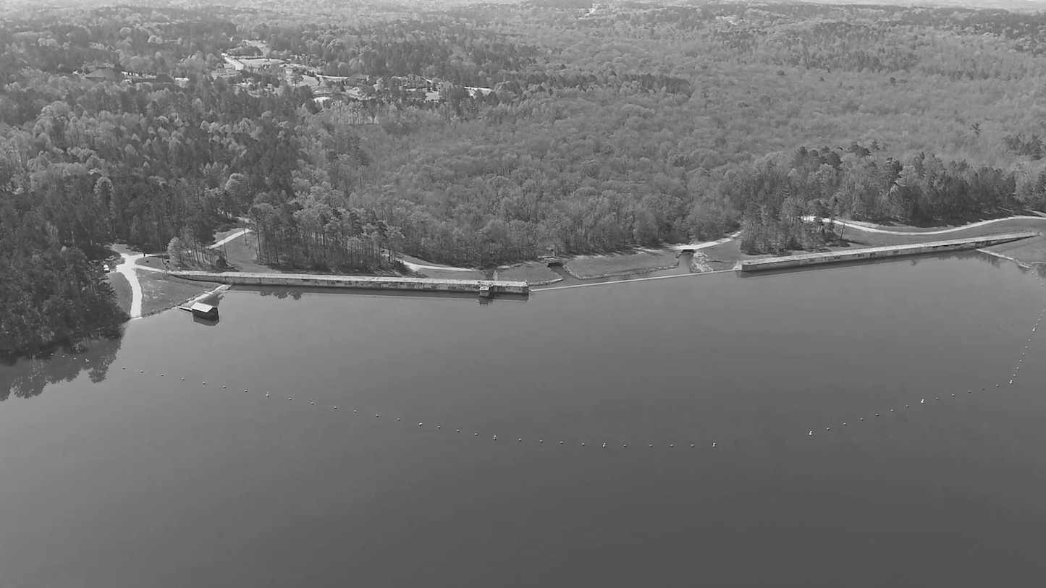
5-Year Capital Improvement Plan
(CIP)
2027-2031

Slide 31
Rockdale County Sheriff’s Office | 111ssssRockdale County | 111ssssRockdale County | 111ssssRockdale County | 111ssssRockdale County | 111ssssRockdale County | 111ssssRockdale County
Five-Year Capital Improvement Plan | Five Year Capital Improvement Plan | Five Year Capital Improvement Plan | Five Year Capital Improvement Plan | Five Year Capital Improvement Plan | Five Year Capital Improvement Plan | Five Year Capital Improvement Plan
Fiscal Year 2027-2031 | Fiscal Year 2023-2027 | Fiscal Year 2023-2027 | Fiscal Year 2023-2027 | Fiscal Year 2023-2027 | Fiscal Year 2023-2027 | Fiscal Year 2023-2027
 | 2027 | 2028 | 2029 | 2030 | 2031 | Five-Year Total
Automotive Equipment | $1,269,596 RCSO Vehicles CID (1), Crime Scene Van (1): $214,916 UPD Cars (15): $1,054,680 | $905,138 CID Cars (2): $166,862 UPD Cars (10): $738,276 | $942,051 CID Cars (2): $166,862 UPD Cars (10): $775,189 | $980,897 CID Cars (2): $166,862 UPD Cars (10): $814,035 | $1,021,598 CID Cars (2) $166,862 UPD Cars (10): $854,736 | $5,119,280
Technology Programs & Improvements | $299,232 Block Locker (1), Latitude 7220 Tablets (15), Pocket Jet 863 (15): $209,829 PLC/SCADA: Critical Updated Needed ($89,403) | $150,000 20 Body Cameras |  |  |  | $449,232
Construction & Heavy Equipment | $108,829 Front Jail Reception HVAC (1) | $120,000 6A/6B HVACS (2) $60,000 per HVAC | $60,000 Central Control HVAC (1) |  |  | $288,829
Building Improvements/Renovations/Expansions |  |  |  | $2,000,000 Mental Health Stabilization Unit Expansion |  | $2,000,000
TOTALS | $ 1,677,657 | $ 1,175,138 | $ 1,002,051 | $ 2,980,897 | $ 1,021,598 | $ 7,857,341

Slide 32
Rockdale County (Sheriff’s Office) Five-Year Capital Improvement Plan Fiscal Year 2027-2031
 | 2027 | 2028 | 2029 | 2030 | 2031 | Five-Year Total
Automotive Equipment | $1,269,596 | $905,138 | $942,051 | $980,897 | $1,021,598 | $5,119,280
Technology Programs & Improvements | $299,232 | $150,000 |  |  |  | $449,232
Construction & Heavy Equipment | $108,829 | $120,000 | $60,000 |  |  | $288,829
Building Improvements/Renovations/Expansions
New Buildings |  |  |  | $2,000,000 |  | $2,000,000
TOTALS | $ 1,677,657 | $ 1,175,138 | $ 1,002,051 | $ 2,980,897 | $ 1,021,598 | $ 7,857,341
Notes:
32

Slide 33

Thank You

