Slide 1

Rockdale Water Resources
2027 OPERATING AND 5-YEAR CIP
BUDGET PRESENTATION
FY27 - Budget Request
Presenter: Director, Kimbry L. Peek, Sr.
Date: August 4th, 2026

Slide 2
Vision, Mission & Values
Department Statements
    VISION
    To be the premier water and sewer utility in the State of Georgia, championing economic development & service delivery, while embracing environmental stewardship in Rockdale County
Rockdale
Water Resources
    MISSION
    Remain Perfectly Positioned to provide the ultimate natural resource ….WATER.
    VALUES
    Quality, Dependability & Exceptional Service

Slide 3
Opportunities & Challenges
SUCCESSES
OPPORTUNITIES
CHALLENGES
19th Consecutive Platinum Award (Gees Mill WTP)
Launched New Online Portal (SilverBlaze)- Leak Detection and Process Automation
Platinum Awards for the five Wastewater Treatment Facilities
2025 Consumer Confidence Report confirming no contaminations or violations in our drinking water
Implemented New Warehouse Inventory and Asset Management Technology (Sortly)
Launched Daupler technology (Response Management System)
ISI/Water Company of America- Audit of all water/sewer accounts/field assets
Successfully completed Water Distribution Class in partnership with ARC
  Competitive Job Market
  Increase in Cost of Material and Supplies
Aging Infrastructure (Water Treatment Plant & Water Supply Dam)
Recruiting & Retaining Certified Water Distribution Operators in the Competitive Job Market
Maintaining Rolling Stock Levels
Long-Term Funding for Capital Improvement Projects
  Focus on Aging Water and Sewer Infrastructure
  Workflow management
Wastewater Capacity
Additional Grant funding
Provide additional training/career development for staff
Educational Outreach
Upgrade/Implement New CRM/ERP system
Implement Wastewater Collection Operator certification course in partnership with ARC

Slide 4
FY27 Goals & Initiatives
Department’s Reimagine Rockdale Strategic Plan
Access
Review, Repair and Replace Aging Infrastructure (Water and Sewer)
Multiple GDOT/RDOT Water and Sewer Relocation Projects
Replacement of Copper and Lead Water Service Lines
Equity
Continuing Education/Training for Leaders and Emerging Leaders
Partner with Local PTAs, Schools and Social/Civic Groups through our Utility Education Program
Audit Water and Sewer Accounts
Water Distribution and Wastewater Operator Collection Certification Program with ARC
Innovation
Champion Conservation and Reduce Financial Impacts to the Utility and its Customers by Automating Leak & High Consumption Alerts
Implement Streamlined and Self-Service Options (e.g. Payment Kiosk) for Customer Care & Business Affairs
Expand SmartCap Leak Detection Program
Implement Testing, Repair and Replacement of Large Commercial Meters

Slide 5
Operating Budget Summary
*Report Provided by Finance
 | Budget FY 2026 | Proposed FY 2027 | Change
Total Operating Expenses | $45,780,976 | $47,472,989 | $1,692,013
Total Personnel Services & Benefits | $7,336,960 | $7,574,171 | $237,211
Total Est. Budget impact | $53,117,936 | $55,047,161 | $1,929,224
The Operation and Maintenance Budget decreased by $12,750 year over year
Increase to Bond Payments $1.4M and Depreciation Expense $200k are major drivers to increase of the Operating Expenses
3% Increase to Personnel Services & Benefits attributed to Performance Reviews/COLA

Slide 6
Operating Budget Request
* Include changes of $5,000 or greater only
 | Description | FY26 Budget | FY27 Cost | Amount Change
Repair and Maintenance | Maintains and repairs the water distribution and wastewater collection infrastructure through preventive maintenance, emergency response, and system improvements to ensure safe, reliable, and uninterrupted utility services. | 1,815,810 | $1,834,638 | $18,828
Gasoline/Diesel | Provides fuel for department vehicles and equipment to support daily operations and emergency response. | $111,500 | $119,000 | $7,500
Technical Services | Contractual services for Water, Wastewater, Customer Service and Engineering Operations​ (e.g. Inframark, CERM and Daupler) | $14,968,361 | $14,974,302 | $5,941
General Supplies and Material | Water and Wastewater material and supplies for Collection and Distribution Operations and Water and Wastewater Treatment Facilities | $2,386,799 | $2,392,049 | $5,250

Slide 7
Operating Budget Request Justification
Requests
Repair and Maintenance $18,828
  Increased funding supports the rising cost of maintaining and repairing water distribution and wastewater
  collection infrastructure to ensure safe, reliable, and uninterrupted utility services.
  ​Gasoline/Diesel $7,500
  Supports the day-to-day operation of department vehicles and equipment needed to maintain utility
  infrastructure, support routine field activities and respond to service needs and emergencies.
    Technical Services $5,941
  Contractual services required to maintain Water, Wastewater, Customer Service, and Engineering operations
  and meet ongoing operational needs.
    General Supplies and Maintenance $5,250
  Materials and supplies needed to maintain water and wastewater collection, distribution, and treatment
  operations and ensure reliable utility services.
  Although there were minimal increases to above line items, the overall Operation and Maintenance Budget decreased by $12,750 year over year

Slide 8
RWR Organization Chart (Current)
Administration Division
Director
Business Administration Manager
General Manager (Infrastructure)
General Manager (Cust Care & Bus Aff)
General Engineering Manager
Project Manager
Deputy Director
Vacancies
None

Slide 9
RWR Organization Chart (Current)
Finance & Strategic Services Division
Vacancies
None
Deputy Director
Sewer Rehab Infrastructure Manager
Compliance Manager
Business & Financial Analyst
Capital Projects

Slide 10
RWR Organization Chart (Current)
Finance & Strategic Services Division (Cont.)
Vacancies
None
Sewer Rehab Infrastructure Manager
Sr. Utility Tech
Field Inspector
Field Inspector
Contractors
(Sewer Rehab Contract Support Team)
CERM Employees
Administrative Operations Coordinator

Slide 11
RWR Organization Chart (Current)
Infrastructure Division
Vacancies
None
General Manager
Infrastructure
Water Treatment Plant Manager
Water and Sewer Ops Manager
Warehouse Manager
Warehouse Operator
Contract Support
(ESG)
Collection & Distribution Ops (ESG)
Wastewater Treatment Facilities Ops (ESG)

Slide 12
RWR Organization Chart (Current)
Infrastructure Division (Cont.)
Vacancies
None
Water & Sewer Operations Manager
Superintendent Water
Superintendent Sewer
Sewer Collection Inspector
Utility Locate Tech
CSR Dispatch
CSR Dispatch
Backflow Coordinator
Utility Locate Tech
Water Distribution Inspector
Water Quality Coordinator
Water Quality Tech (4)

Slide 13
RWR Organization Chart (Current)
Infrastructure Division- Water Treatment
Vacancies
None
Water Treatment Plant Manager
Water Treatment Plant Superintendent
Chief Operator
Mechanical Maintenance Supervisor
Administrative Coordinator
Water Supply Tech Coordinator
Water Supply Tech

Slide 14
RWR Organization Chart (Current)
Infrastructure Division- Water Treatment (Cont.)
Vacancies
None
Water Treatment Plant Superintendent
Lab Tech Coordinator
Lab Tech II

Slide 15
RWR Organization Chart (Current)
Chief Operator
Water Treatment Operator
Water Treatment Operator
Water Treatment Operator
Water Treatment Operator
Lead Operator
Water Treatment Operator
Water Treatment Operator
Water Treatment Operator
Water Treatment Operator
Infrastructure Division- Water Treatment (Cont.)
Vacancies
None

Slide 16
RWR Organization Chart (Current)
Maintenance Supervisor
SARV/WARV Maintenance Coordinator
Water Maintenance Coordinator
Maintenance Specialist
Maintenance Specialist
Maintenance Specialist
Maintenance Specialist
Infrastructure Division- Water Treatment (Cont.)
Vacancies
None

Slide 17
Current Organization Chart
Engineering
Engineering & Construction Manager
Principal Engineer
General Engineering Manager
Superintendent of Inspections
Engineering Tech
Administrative Coordinator
Water and Sewer Inspections (2)
Contract Support
(CERM)
Vacancies
None

Slide 18
RWR Organization Chart (Current)
Customer Care & Business Affairs
Vacancies
None
General Manager
(Customer Care & Business Affairs)
Customer Service Manager
Business Affairs Manager
Administrative Operations Coordinator

Slide 19
RWR Organization Chart (Current)
Customer Care & Business Affairs (Cont.)
Vacancies
None
Customer Service
Supervisor
Customer Acct
Specialist
(2)
Customer Service Representative (I,II,III)
(8)
Customer Service Advocate
Customer Service
Manager

Slide 20
RWR Organization Chart (Current)
Customer Care & Business Affairs (Cont.)
Vacancies
None
Business Affairs Manager
Customer Account & Business Services Liaison
Billing Specialist
Field Services Technician Supervisor
Senior Field Services Technician
Field Services Technician I
Field Services Technician
Field Services Technician I
Collection Specialist
Field Services Technician II
Customer Acct Specialist

Slide 21
Proposed Organization Chart
Fiscal Year 2027- Finance & Strategic Services Division
Personnel Request
Reclass Sr Utility Tech to Field Inspector
Sewer Infrastructure
Manager
Field Inspector
Field Inspector
Field Inspector
Contractors
(Sewer Rehab Contract Support Team)
CERM Employees
Administrative Operations Coordinator

Slide 22
Proposed Organization Chart
Fiscal Year 2027- Infrastructure
Water & Sewer Operations Manager
Superintendent Water
Superintendent Sewer
Sewer Collection Inspector
Utility Locator Services Supervisor
CSR Dispatch
CSR Dispatch
Contract Support
Collection & Distribution Ops (ESG)
Wastewater Treatment Facilities Ops (ESG)
Backflow Coordinator
Utility Locate Tech
Water Distribution Inspector
Water Quality Coordinator
Water Quality Tech (4)
Utility Locate Tech
Personnel Request
Utility Locator Services Supervisor

Slide 23
Proposed Organization Chart
Fiscal Year 2027- Customer Care & Business Affairs
Business Affairs Manager
Billing Supervisor
Billing Specialist
Field Services Technician Supervisor
Senior Field Services Technician
Field Services Technician I
Field Services Technician
Field Services Technician I
Field Services Technician II
Customer Acct Specialist
Customer Account & Business Services Liaison
Collections Specialist
Personnel Request
Billing Supervisor

Slide 24

Personnel Budget Request
FY26 Budgeted Department Total- 89
FY27 Requested Additional Personnel – 2
Job Title | Fund | Division |  | FTE or PT | Head Count | Request Type | Salary +40% Benefits
Billing Supervisor | 505 | 1590 |  | FTE | 1 | New Position | $71,053
Utility Services Supervisor | 505 | 4440 |  | FTE | 1 | New Position | $71,053
Field Inspector | 505 | 4331 |  | FTE |  | Reclass | $63,133
 |  |  |  |  | Total Est. Budget impact |  | $205,239
New Department Total (w/Request)- 91
13

Slide 25
Personnel Budget Request Justification
New Position Request
Billing Supervisor 1 FTE - $71,053
Oversees and participates in all County water billing operations by supervising staff, ensuring accurate and timely billing in compliance with Rockdale Water Resources ordinances, policies, and procedures, resolving complex billing issues, monitoring revenue and billing performance, and collaborating with internal departments to protect utility revenue, maintain regulatory compliance, and provide exceptional customer service.
Utility Locator Services Supervisor 1 FTE - $71,053
    Provide dedicated oversight of utility locating operations, improve damage prevention and regulatory compliance, enhance response times and service quality, ensure workforce accountability, and protect the County's critical water and wastewater infrastructure.
Field Inspector Reclass - $63,133
    The position is being reclassified to Field Inspector to align the employee's classification with the higher-level inspection, contractor oversight, and project management responsibilities currently being performed in support of the County's expanding Sewer Rehabilitation Program.
Reclass Position Request

Slide 26
5 Year Capital
IMPROVEMENT PLAN
(CIP)
2027-2031
10

Slide 27
Rockdale County RWR Five-Year Capital Improvement Plan Fiscal Year 2027-2031
 | 2027 | 2028 | 2029 | 2030 | 2031 | Five-Year Total
Automotive Equipment | $140,700.00 | $147,000.00 | $153,300.00 | $160,650.00 | $147,000.00 | $748,650.00
Technology Programs & Improvements | $960,000.00 | $0.00 | $0.00 | $0.00 | $0.00 | $960,000.00
Construction & Heavy Equipment | $200,000.00 | $0.00 | $0.00 | $0.00 | $0.00 | $200,000.00
Building Improvements/Renovations/Expansions | $380,000.00 | $245,000.00 | $50,000.00 | $50,000.00 | $50,000.00 | $775,000.00
New Buildings | $0.00 | $0.00 | $0.00 | $0.00 | $0.00 | $0.00
Infrastructure Improvements | $31,590,000.00 | $28,180,000.00 | $17,510,000.00 | $22,640,000.00 | $3,350,000.00 | $103,270,000.00
TOTALS | $33,270,700.00 | $28,572,000.00 | $17,713,300.00 | $22,850,650.00 | $3,547,000.00 | $105,953,650.00
Notes:
27

Slide 28
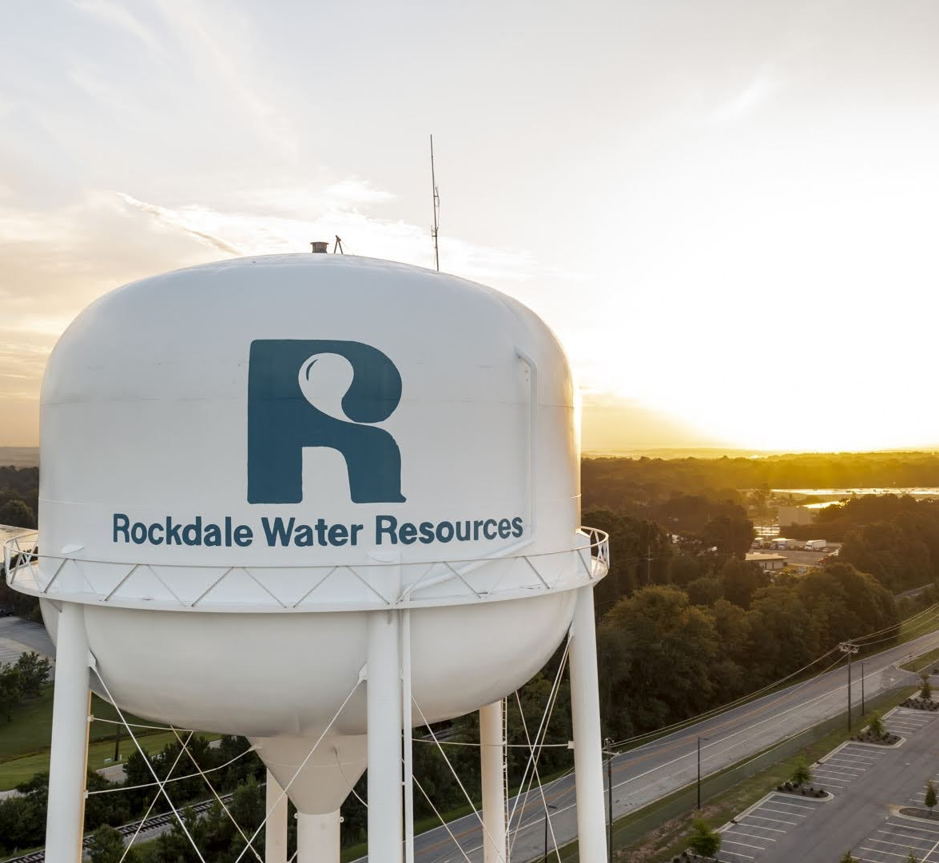
Thank You

