Slide 1

State Court A
2027 OPERATING AND 5-YEAR CIP BUDGET PRESENTATION
FY27 - Budget Request
Presenter: Chief State Court Judge V.T. McRae
Date: August 6th, 2026

Slide 2
Vision, Mission & Values
Department Statements
    VISION
  Ensure the Fair, Efficient, and Impartial Administration of Justice;
STATE COURT A
    MISSION
  Efficient Court Operations, Reduce Backlog, and provide Accessibility to Court for Rockdale County Citizens.
    MISSION
    VALUES
  Integrity, Fairness, Impartiality, and the Rule of Law

Slide 3
Opportunities & Challenges
SUCCESSES
OPPORTUNITIES
CHALLENGES
Established Veterans Accountability Court:
Approved by the Georgia Legislature and signed into law. Recommended by the Council of Accountability Court Judges.
Night Traffic Court One Year Anniversary:
Permits Working Citizens the opportunity to have their traffic citations handled in the evening without missing work during the day.
Jail Court:
Provides opportunity for misdemeanor cases to be handled expeditiously, especially for citizens that cannot post bail for non-violent offenses. Held the beginning and middle of the month.
1) Unfilled Attorney Positions in the Public Defender’s Office: Protect the Rights of Indigent Defendants in Criminal Misdemeanor Court
Short Term Plan: Six-Month Plan. Multiple Course of Actions (Use State Funds or existing County Funds for Contract Appointed Attorneys.)
Longterm Plan: Explore solutions from other jurisdictions.
2) Use of Technology:
Stay Current with AI (Artificial Intelligence) Case Law and Ethical Use.
Maximize Software Contracts: Odessey, Lexis-Nexus,
Website Enhancements: Provide More Information for the Public to increase knowledge of Court Operations. (Pattern after other Jurisdictions)
Maximize Video Conferencing: Access to Court for Citizens and Attorneys. Time and money saved. (Efficient Court Operations and Accessibility)
New Court House Operations: Moving to new courthouse and incorporating all stakeholders for Safe and Efficient Operations.
Provide Competitive Pay to Attract Top Talent

Slide 4
Numbers in Perspective Training

Slide 5
Numbers in Perspective Criminal
Overall case management has improved, with the disposal rate increasing from 92.6% in 2025 to 93.7% through July 17, 2026.
Adult Criminal dispositions improved substantially, increasing from 57.4% in 2025 to 72.5%.
Serious Traffic and Other Traffic each disposed of more cases than were filed, indicating progress in reducing prior backlogs.
Traffic Citations continue to represent the vast majority of the court's workload (about 80% of all filings) and maintain a strong 94.0% disposal rate.
The court has added 188 net pending cases so far in 2026, compared with 367 over the entirety of 2025.
Overall, these mid-year numbers suggest continued strong case processing, particularly in reducing existing traffic-related backlogs while improving adult criminal case resolution.
Notes:
Overall Statistics of 01/01/2025 – 12/31/2025
Total cases filed: 4,984
Total cases disposed: 4,617
Cases remaining (net increase): 367
Overall disposal rate: 92.6%
Percentage of Total Filings
Traffic Citations: 74.9%
Other Traffic: 14.1%
Adult Criminal: 6.7%
Serious Traffic: 2.3%
Probation Revocation: 1.7%
Ordinance Violations: 0.2%
Percentage of Total Dispositions
Traffic Citations: 80.3%
Other Traffic: 11.6%
Adult Criminal: 4.2%
Serious Traffic: 2.1%
Probation Revocation: 1.9%
Ordinance Violations: 0.02%
Overall Statistics of 01/01/2026 – 07/17/2026
Total cases filed: 2,974
Total cases disposed: 2,786
Net increase in pending cases: 188
Overall disposal rate: 93.7%
Percentage of Total Filings
Traffic Citations: 80.3%
Other Traffic: 10.0%
Adult Criminal: 6.7%
Probation Revocation: 2.0%
Serious Traffic: 0.8%
Ordinance Violations: 0.2%
Percentage of Total Dispositions
Traffic Citations: 80.5%
Other Traffic: 10.9%
Adult Criminal: 5.2%
Probation Revocation: 2.0%
Serious Traffic: 1.3%
Ordinance Violations: 0.1%

Slide 6
Numbers in Perspective Civil
Compared with 2025, the court's overall disposition rate improved from 44.31% to 63.13%, an increase of 18.82 percentage points. The most significant gains occurred in Auto Accident and Other General Civil cases, where dispositions exceeded new filings and reduced backlog. Contracts/Accounts, while showing improvement, remains the court's largest case type and continues to generate most of the increase in pending cases because filings still exceed dispositions.
Notes:
Key Findings
Overall Performance
2025: 810 dispositions out of 1,828 filings = 44.31%
2026 YTD: 714 dispositions out of 1,131 filings = 63.13%
Improvement: The overall disposition rate has increased by 18.82 percentage points, indicating the court is disposing of cases at a faster pace relative to new filings than it did in 2025.
Largest Improvements
Tort – Auto Accident: 55.00% → 135.29% (+80.29 points), suggesting the court is resolving older cases faster than new ones are being filed.
Other General Civil: 47.62% → 112.50% (+64.88 points), indicating a reduction in backlog.
Tort – Other: 72.73% → 100.00% (+27.27 points), meaning the court kept pace with filings.
Contracts/Accounts: 42.10% → 58.98% (+16.88 points). Although improved, this high-volume category still has a disposition rate below 100%, so it continues to add to the pending caseload.
Areas That Declined
Garnishment: 54.93% → 32.65% (−22.28 points), showing filings are outpacing dispositions more than they did in 2025.
Tort – Premises Liability: 54.55% → 25.00% (−29.55 points), indicating slower processing in this category.

Slide 7
FY27 Goals & Initiatives
Department’s Reimagine Rockdale Strategic Plan
Access
Provide timely access to courts, by placing cases on calendars such as Night Court, Traffic Court, Arraignment, Calendar Call, Jury Trial, Bench Trial, Motions, PMR, & Bond Forfeiture.
Equity
Give all cases equal due process and attention.
Ensure everyone has their day in court.
Innovation
Utilize technology (Maximize use of videoconferencing): Social Justice Reform, Pre-Trial Diversion, Establishing Veteran’s Court, Odyssey/Case File Management, & Legal Research.

Slide 8
Operating Budget Summary
*Report Provided by Finance
 | Budget FY 2026 | Proposed FY 2027 | Change
Total Operating Expenses | $170,710 | $232,710 | $62,000
Total Personnel Services & Benefits | $534,020 | $556,425 | $22,405
Total Est. Budget impact | $704,730 | $789,135 | $84,405

Slide 9
Operating Budget Request
* Include changes of $5,000 or greater only
 | Description | FY26 Budget | FY27 Cost | Amount Change
Travel | Travel Budget for transportation for conferences, trainings, etc. | $6,000 | $12,000 | $7,000
Education & Training | Education training & training budget for conferences, trainings, certifications, etc. | $5,000 | $25,000 | $20,000
Other Supplies (Accountability Courts) | Accountability Courts including DUI Court, Veterans Court, & Night Court | $50,000 | $27,300 | $23,000

Slide 10
Operating Budget Request Justification
Requests
Travel $7,000
    We are asking for a $7,000 increase to the Travel budget. The increase request comes with the realization that the initial budget was not enough to cover the travel costs for staff training. Budget amendments had to be done to accommodate the cost of travel. This proposed increase would ensure that there is enough funding to provide court staff with proper travel accommodations for training without going into other budget lines.
    Education & Training $20,000
    We are asking for a $20,000 increase to the Education & Training budget. The increase request reflects the cost of training for the Judge, Judicial Assistant, & Law Clerk. The Current budget of $5,000 was not enough to cover the cost of training for Court staff. Budget amendments had to be done to accommodate the cost of education and training. This proposed increase would ensure that court staff is better educated on the most current legal issues, to serve the public and streamline job duties. (Mandatory Judges Fall and Spring Conference, Accountability Court Training, Staff Attorney Training, Tyler Technology Annual Training, etc.)
    Other Supplies (Accountability Courts) $23,000
    We are asking for $14,000 for costs not covered by State & Federal funding for Veterans Court and $9,000 for costs require to run Night Court every month. The costs of Night Court include Attorneys, Bailiffs, Interpreters, Court resources, etc.

Slide 11
Current Organization Chart
Fiscal Year 2026
Vacancies
Veterans Court Coordinator
Chief Judge V.T. McRae
Law Clerk Chery Perry
Judicial Assistant Justin Rupram
Veterans Court Coordinator
(TCB)

Slide 12
Proposed Organization Chart
Fiscal Year 2027
Chief Judge V.T. McRae
Law Clerk Chery Perry
Judicial Assistant Justin Rupram
Veterans Court Coordinator
State & Federal (Grant Funded)
Notes:
Let’s Highlight at the BOC hearing that this position is possibly grant funded.

Slide 13
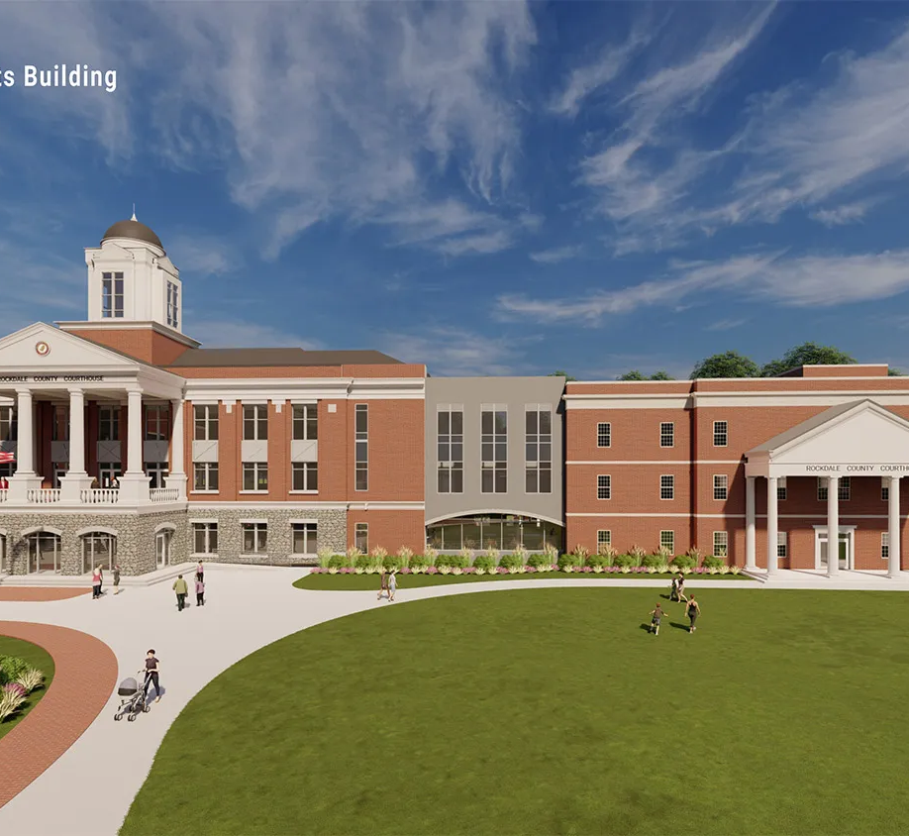

Thank You

