Slide 1

Superior Court II-Judge Bills & Accountability Lab Services
2027 OPERATING AND 5-YEAR CIP
BUDGET PRESENTATION
FY27 - Budget Request
Presenter: Director, Judge Nancy Bills
Date:6/30/2026

Slide 2
Vision, Mission & Values
Department Statements
    VISION
    Maintain the highest standards of judicial ethics and conduct
Superior Court II
Judge Nancy Bills
    MISSION
    Uphold and defend the Constitution and law of the State of Georgia and United States.
    VALUES
    Administer justice and impartially, without prejudice or favor to any party.

Slide 3
Operating Budget Summary
*Report Provided by Finance
 | Budget FY 2026 | Proposed FY 2027 | Change
Total Operating Expenses | $465,245 | $474,245 | $9,000
Total Personnel Services & Benefits | $487,734 | $536,064.98 | $48,330.98
Total Est. Budget impact | $952,979 | $1,010,309.98 | $57,330.98

Slide 4
Current Organization Chart
Nancy N. Bills, Judge
Superior Court II
Law Clerk
Chief Judicial Assistant
Case Manager
TPO Coordinator
Accountability Drug Court/Grant Funded
(6 Positions)
Accountability Lab Services/Lab Funded
(8 Positions)
Program Director Stepping Up Initiative
Family Violence Services Coordinator Grant Funded
(1 Position)
Judicial Assistant
Court Reporter
Peer Support Specialist
Fiscal Year 2026
Vacancies

Slide 5
Proposed Organization Chart
Personnel Changes
Two New Positions
-Alternative Dispute Resolution Director
-TPO Clerk
Fiscal Year 2027
Nancy N. Bills, Judge
Superior Court II
Law Clerk
Chief Judicial Assistant
Family Violence Services Coordinator Grant Funded
(1 Position)
Court Reporter
Judicial Assistant
TPO Coordinator
Accountability Drug Court/Grant Funded
(5 Positions)
Accountability Lab Services/Lab Funded
(8 Positions)
Program Director Stepping Up Initiative
Case Manager
Accountability Drug Cort Coordinator
Peer Support Specialist
TPO Clerk ** New Position**
Alternative Dispute Resolution Director ** New Position**

Slide 6
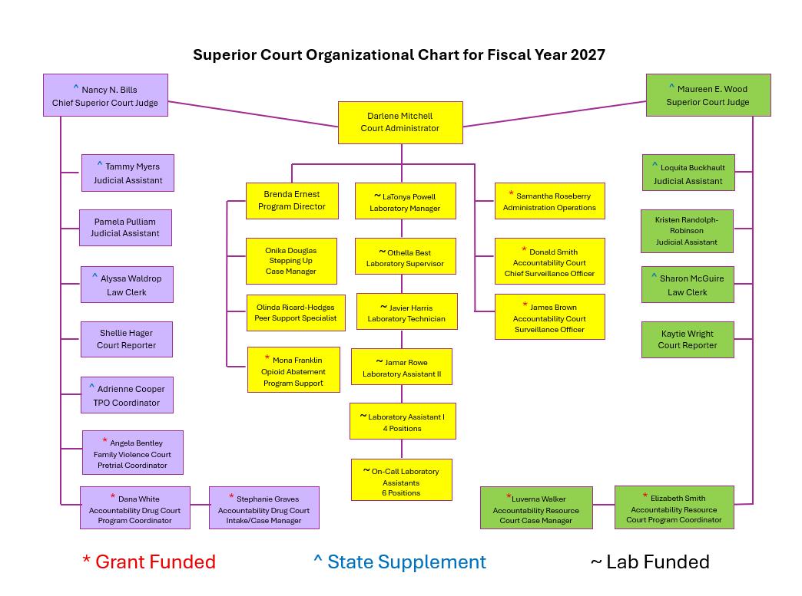

Slide 7

Personnel Budget Request
FY26 Budgeted Department Total- 24
FY27 Requested Additional Personnel – 2
Job Title | Fund | Division |  | FTE or PT | Head Count | Request Type | Salary +40% Benefits
Alternative Dispute Resolution Director | 511110 | 21 |  | FTE | 1 | New Position | $84,000 - $126,000
TPO Clerk | 511110 | 21 |  | FTE | 1 | New Position | $58,800 - $84,000
 |  |  |  |  | Total Est. Budget impact |  | $142,000-210,000
New Department Total (w/Request)- 26
13

Slide 8
Personnel Budget Request Justification
New Position Requests
Alternative Dispute Resolution Director 1 FTE - $$84,000 - $126,000
This position is needed to assist with lengthy pre-trial discovery, prolonged attorney billing and speedier outcomes. This position will help reduce congested court dockets through mediation. Through mediation will help reduce costs, faster resolutions, maintain confidentiality, and preserve relationships through collaborative negotiation rather than adversarial litigation.
Temporary Protective Order Clerk 1 FTE - $58,800 - $84,000
This position is needed to assist the TPO Coordinator (who is State Funded with a County supplement). Due to the increasing number of TPOs being filed in 2024, 2025, and continuing in 2026, the workload has increased substantially. Rockdale County is one of the few counties in the state of Georgia that only has one person handling TPOs. The Judicial Assistants help when the coordinator is in court, on vacation or at lunch but this takes them away from their assigned duties. TPOs are critical and provide emergency protection for victims of domestic violence, stalking, harassment or threats and need to be handled as swiftly as possible.

Slide 9

Thank You

